Slide 1
Hacking Bureaucracy
With 18F
Catherine Devlin
Innovation Specialist
@catherinedevlin catherine.devlin@gsa.gov
@18F
Notes:
Many of you know me from past LinuxFests, or PyOhio, or something similar. I’m a long-term FOSS user, author, database administrator, and Python programmer. And, for the past two years have been the most exciting years of my career.
Welcome to a story about government. Welcome to a happy and exciting story about government.
I’m working in a new-ish Federal agency called 18F. It’s not my first time working for the government; like most people in Dayton, I once worked as a contractor at Wright-Patterson Air Force Base.

Slide 2
My background:
Despair
Notes:
I worked with good people and we did good work, but more and more it felt like the organization was gradually strangling the hope of having really good software services. As the years working there went by, my frustrated rants at the end of each workday got longer and more bitter.
The funny thing is that the organization was full of smart people who wanted to do good work, but put us all together, and we couldn’t, and it seemed like we couldn’t change anything.
Many of you have similar feelings from past - maybe present - workplaces, whether in government or not. Sometimes it feels like there’s an evil anti-intelligence at work in any large organization.
So I left, and spent a few years working for private companies that did software development more or less well.

Slide 3

Notes:
Meanwhile, elsewhere, some people were doing something better than despairing.
In 2012, the Presidential Innovation Fellowship was born. We 18F’ers call it PIF. PIF invites technical pros from industry to take short-term tours of duty to work on projects with the potential to save lives, save taxpayer money, fuel job creation, and generally make government better.

Slide 4

Notes:
During its 2nd year, the PIF program was placed under the GSA.
The GSA is a sort of meta-government agency, an agenciy that helps other agencies with their boilerplate. If the department of Interior, or Commerce, or Transportation needs building space, they’ll commonly lease it from the GSA. If they need to buy office chairs, they’ll probably buy them through the GSA.

Slide 5

Notes:
At the end of the first year, several of the PIFs - including David Caraway from Dayton - wanted to stretch for the sort of impact they could only have with a longer engagement. A “perma-PIF program” was envisioned. “18F” may be an odd name, but it sure beats perma-PIFs.
18F was launched on March 19, 2014. Dave Caraway recruited me and I started the following June.

Slide 6

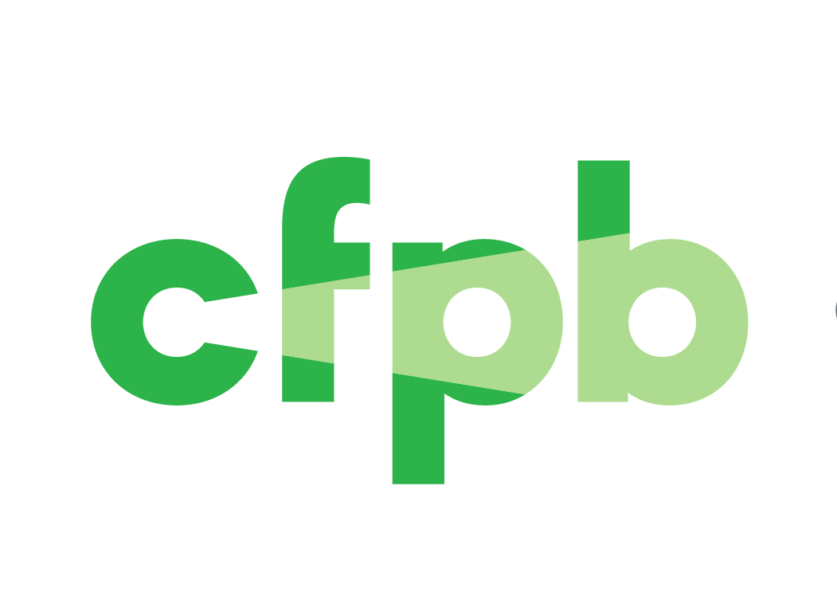

Notes:
Fortunately, 18F is far from alone in its work.
The Consumer Finance Protection Bureau pioneered hiring processes to build an in-house government shop of industry software experts, and helped pioneer releasing the software it develops open-source.
The U. S. Digital Service is administratively completely separate from 18F, but is full of similar technologists with a similar mission. We communicate and cooperate a lot.
Finally, the initial successes of 18F and the PIFs have inspired the GSA to formalize them, along with its own OCSIT, into a Technology Transformation Service. This takes us thoroughly out of the realm of a temporary experiment and means that we’re in it for the long haul.

Slide 7
What 18F does
Notes:
18F is a digital consultancy within the Federal Government. We are Federal employees, but we also have a set of skills and a way of working that’s uncommon.
Federal agencies come to 18F for help with improving their digital presence, improving citizens’ experience with their government. We make contract-like arrangements where we work together with the agency to make something that’s going to delight them and the Americans who work with them.

Slide 8
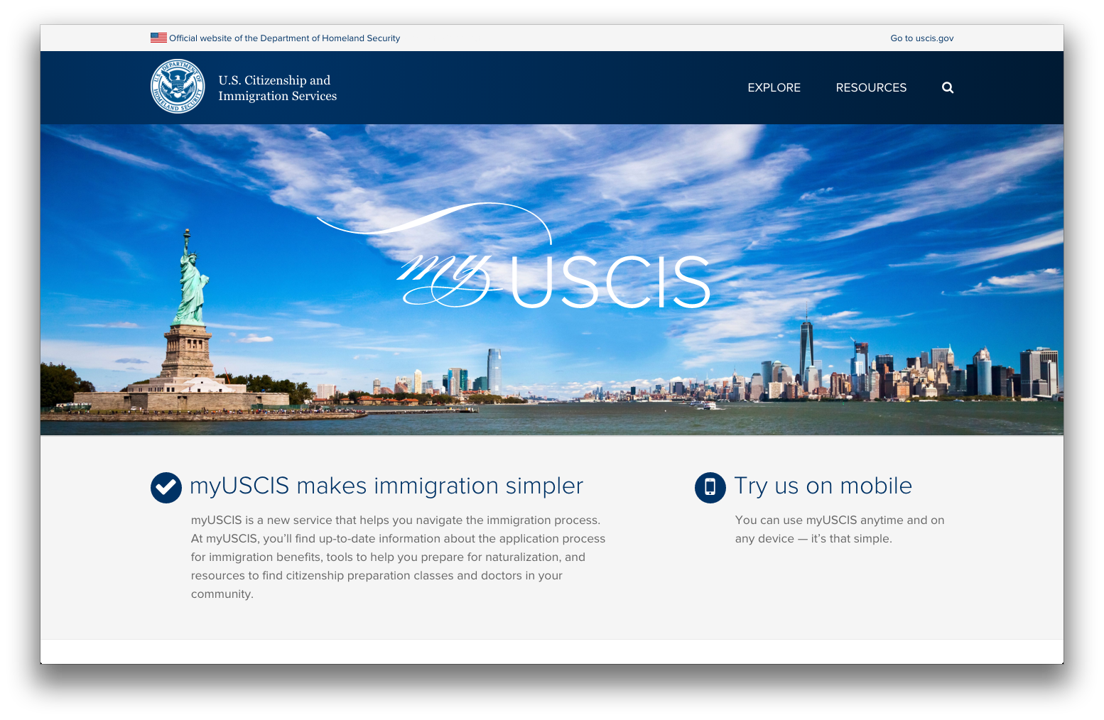
Notes:
Or the not-yet-Americans. We’re working with the U.S. Citizenship and Immigration Services to make it easier for potential citizens to navigate the immigration process. This is is a critical, stressful step in people’s lives that shouldn’t have to be dependent upon experts.

Slide 9
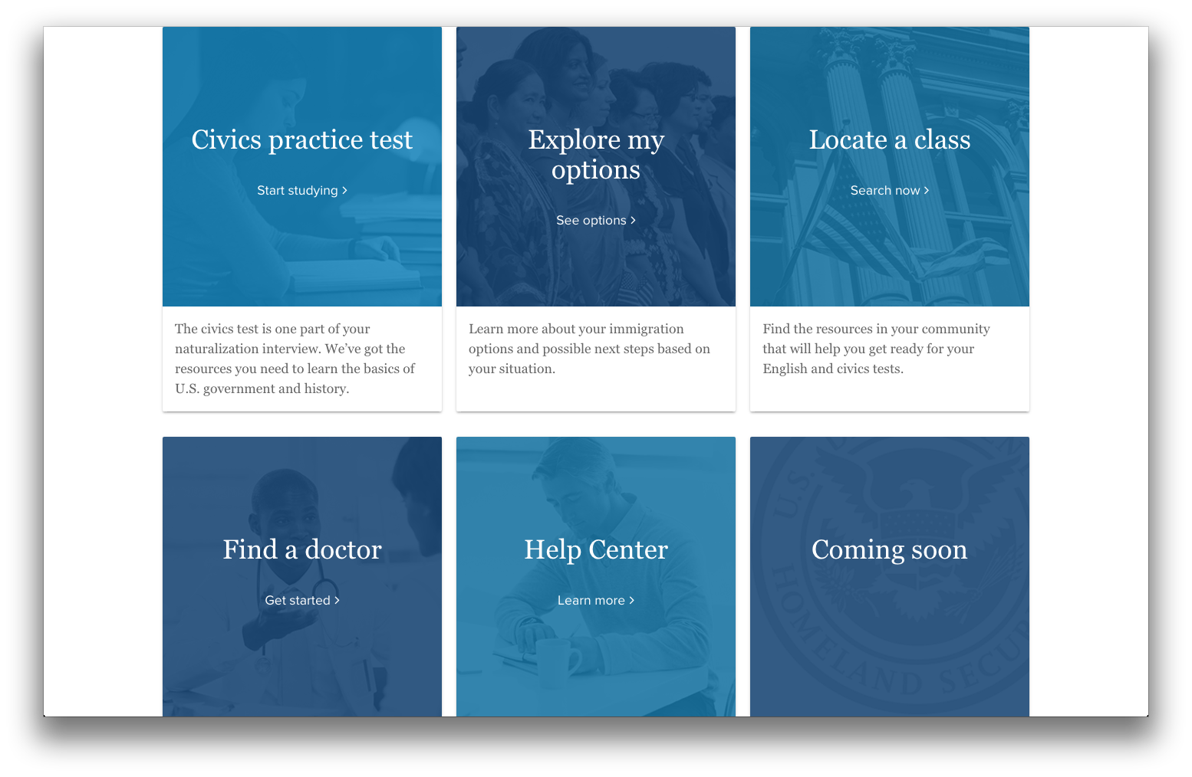
Notes:
18F has contributed to a wide range of immigration projects, including:
an account management system supporting a few hundred thousand immigrants
a searchable help center and guide to naturalization written in plain language, not legalese
and several tools to help you understand what forms and processes you’ll need to complete

Slide 10
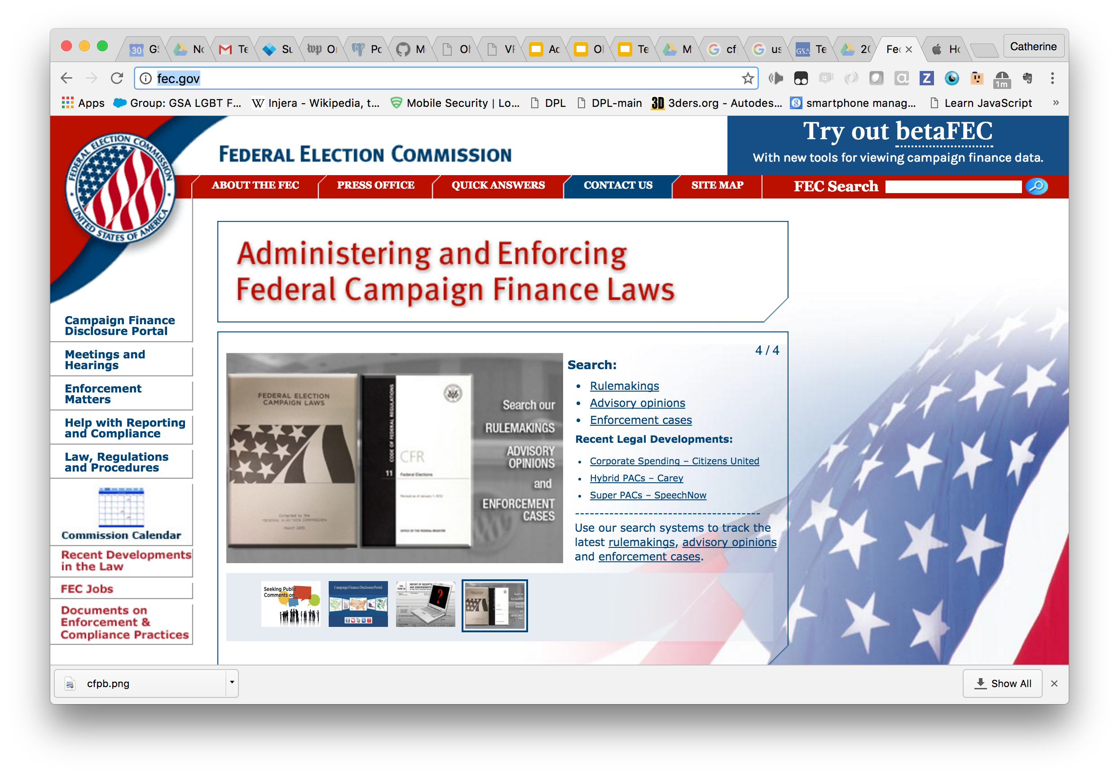
Notes:
The Federal Election Commission came to 18F because they’re not satisfied with their current web presence.

Slide 11
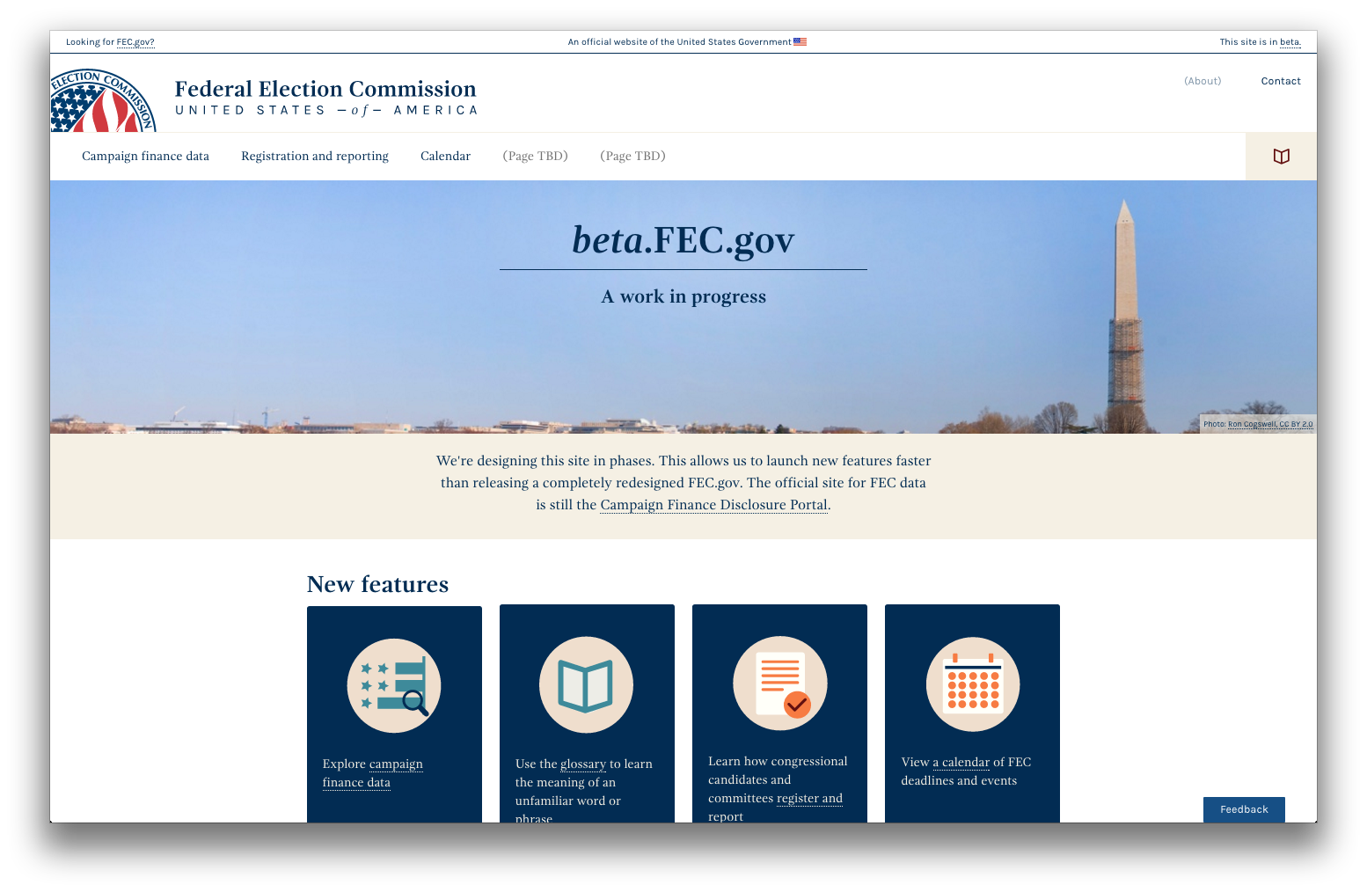
Notes:
So 18F is developing beta.FEC.gov with them, a better experience to help us all get information about campaign spending more effectively.

Slide 12
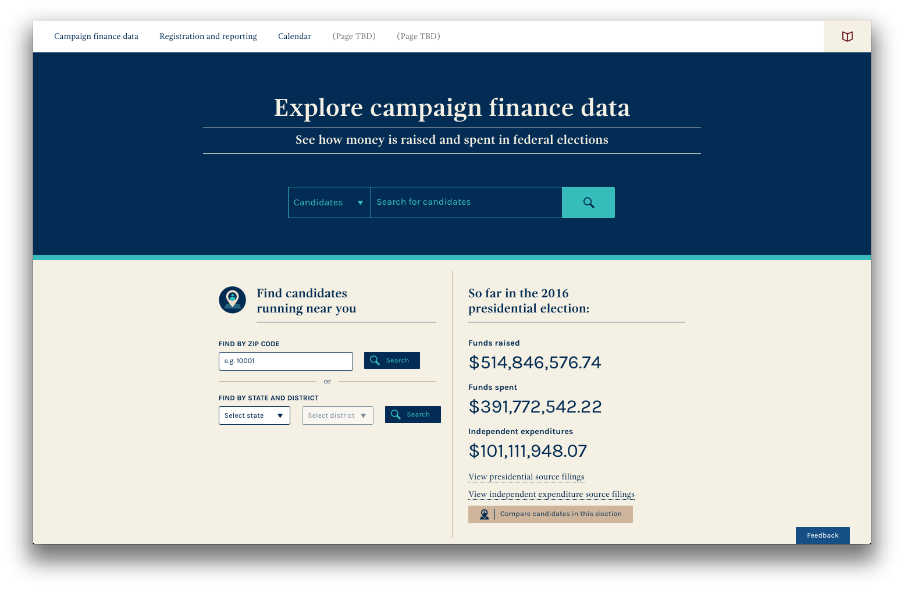
Notes:
We have fantastic user experience designers who helped us expose data with a good-looking, functional interface.

Slide 13
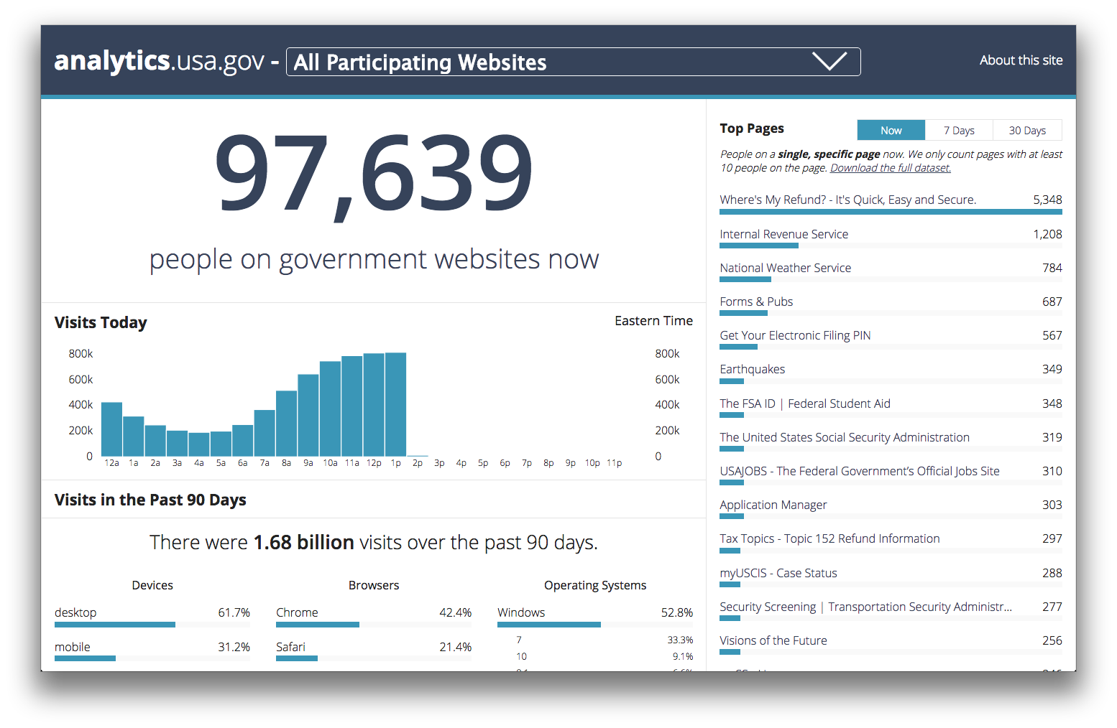
Notes:
We also helped build a public analytics dashboard for U.S. government web traffic. So now for the first time, you can see up-to-the-minute stats on government websites—which pages are most popular, which devices, browsers, and operating systems people are using, and more. It’s distractingly fun to look at, but it’s also serious business - it helps the managers of government websites know what’s working, what the demand is, and what equipment they should account for.

Slide 14
18f.gsa.gov/
what-we-deliver/
Notes:
There is a ton more that I invite you to browse.
We’ve executed more than 100 agreements with over 40 agencies (and those are old stats) to help them deliver on their missions in a design-centric, agile, open, and data-driven way.

Slide 15
Transformation
Notes:
But really, this is what 18F is about. If we build some nice web services, and then go away with the institution unchanged, we fail.

Slide 16
MISSION
18F will transform how the
U.S. Government builds, buys, and shares digital services.
Notes:
This is the mission we’ve embarked upon: to fundamentally transform how the U.S. Government builds, buys, and shares digital services.

Slide 17
Transformation the 18F way
HOW?
1
2
3
People
Practices
Culture
Notes:
“How” is a big, big question.
Notice that there’s no “P” for Policy here. Not that policy is irrelevant, but it’s not sufficient.
Big transformation happens a little at a time.
It happens when one person steps up and says “I think we should do this differently,” and that prompts someone else to step up, and then another, and then another.
Then practices and behavior starts to change. You give people a new way to see problems, a new method of investigating, expectations start to change.
And then suddenly the culture starts to shift.

Slide 18
1/ People
PART ONE
Notes:
The first piece of our transformation equation is PEOPLE.

Slide 19
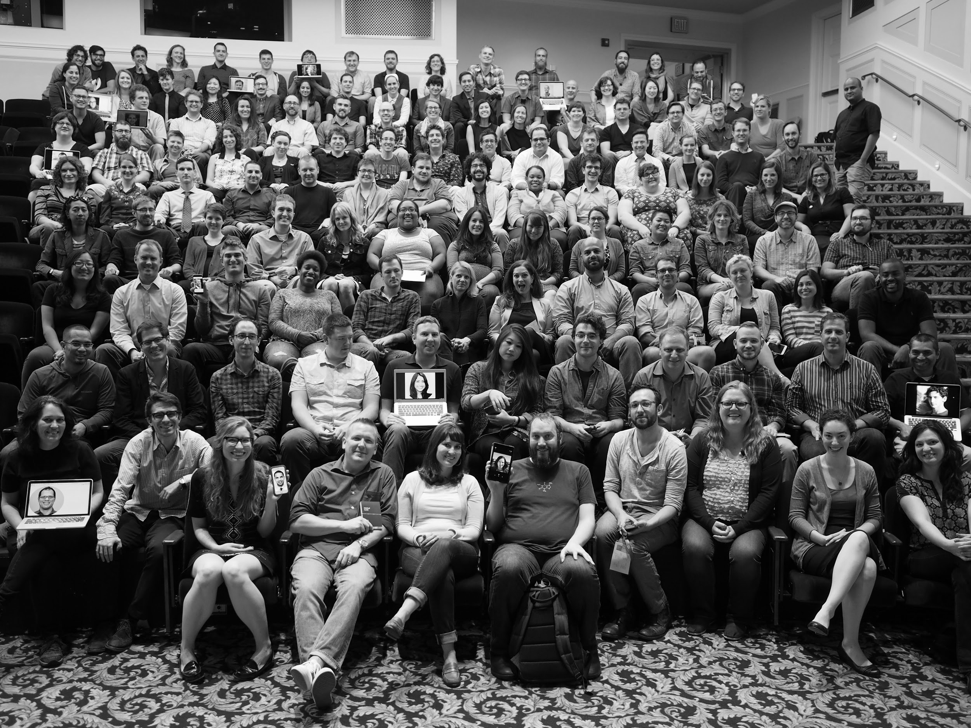
September 2015
Notes:
Here we are a year ago. There are about 200 of us now.

Slide 20
WE ARE
Software developers
DevOps engineers
Designers
UX
Content authors
Product strategists...
Notes:
Professionally speaking, 18F is a group of amazing professionals: software developers, DevOps engineers, designers, user experience experts. Some media pieces describe us as being full of Silicon Valley hotshots, and we certainly have our share, but the breadth of people is our strength. From tech powerhouses, from startups, from nonprofits, from ordinary-seeming companies, from government at all levels, we bring modern skills to the mix.

Slide 21
Two hundred lovers of openness.
Notes:
We are you!
Lovers of open-source software: not just to use, but to create and contribute to.
Lovers of open standards.
Lovers of open data.
We interview new team members for their technical skills, but we also have a “Core Values” interview for every prospective team member. We want to know why they want to go into public service, and why they want to do it with open software and open values.

Slide 22

Notes:
Pretty much every organization has some lovers of openness scattered here and there. But each of you can still feel like a lone voice crying out in the wilderness. Discussions that should move quickly toward solutions bog down in retreading old FUD.

Slide 23
Notes:
But having a solid phalanx of them means no internal resistance whatsoever to being open.
It means being automatically unanimous on the important question of openness…
… which means the discussion can focus on more important questions!
And it brings that much more experience and ideas about how to apply open technologies successfully.

Slide 24
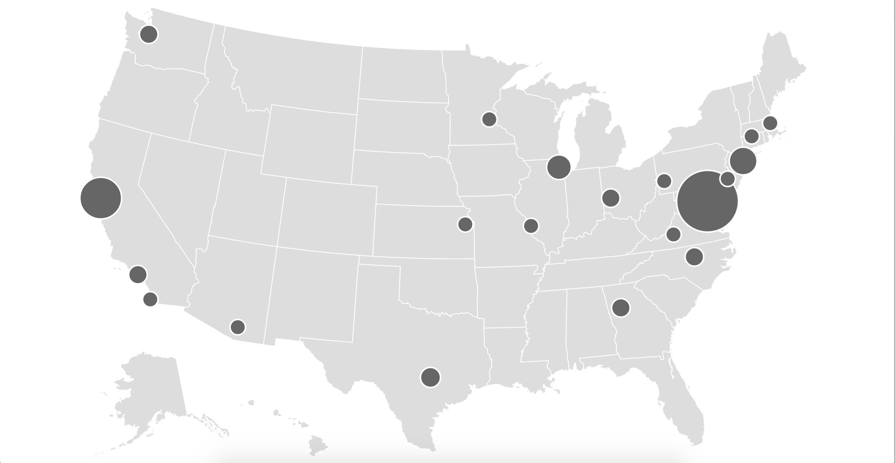
165 people
45% DC 55% everywhere else
Notes:
And we’re all over the place!
I have personally worked with team members from Washington, the Bay Area, Los Angeles, Minnesota, Chicago, Massachusetts, Pennsylvania, Mississippi, North Carolina, Kansas, New York… and I’ve still missed a bunch of spots.

Slide 25
REMOTE IS AWESOME
Broadens perspectives
Forces good communication
Brings the talent
Keeps us sane
Notes:
“Silicon Valley” vs. “The Beltway”
Well, we’ve got plenty of both, and so much more...

Slide 26
Not a bunch of heroes.
PEOPLE
Notes:
Now, there are a lot of truly amazing people at 18F.
But individual heroism can only get you so far. Individuals can only pull off so much. Sometimes brilliant people who don’t know how to work together can do more harm than good.
But our real superpower is the way we work together. Recent research shows pretty clearly that group intelligence is more important than individual intelligence…
There’s also the use of “heroism” to mean over-the-top labors, crazy rushes against deadlines, etc. We avoid that, too. We reject the myth that it’s necessary to achieve great things.

Slide 27
GROUP INTELLIGENCE
Learn from one another
Egoless programming
Self-directing
Core values
Notes:
Learning: We take advantage of the variety of experience that we arrive with. We’re always discussing and learning from each other better hard and soft skills.
Egoless: we really try to be humble with one another. We’ve got nothing to prove. And when you can work without egos getting in the way - when we can use or critique or change or discard code without worrying about whose it is - is makes for better code.
Self-directing: We’re full of working groups and guilds, any of us can volunteer for to help guide the organization. Our hiring, training, code of conduct, diversity efforts, code standards, career planning, so much more… those decisions are spread out to those who step up to the plate. Much like a FOSS community, except for the part where we get paid.
Core values: We make sure 18F team members know from before they even start how and why to value openness, service, modern development practices like agile; and we keep reinforcing that knowledge for each other. We’re about good values as much as we’re about good technical skills.

Slide 28
2/ Practices
PART TWO
Notes:
So we have the people, and we get to work. Here’s a little about how.

Slide 29
Delivery is the strategy.
Just start.
MVP.
Learn and iterate.
Notes:
What that means to us is that it’s important to Just. Get. Started. Do not fall into the trap of thinking that big changes require big plans. The opposite is closer to the truth.
Build something small that you can put in front of real users, learn from it, and do it again.

Slide 30
Freedom to fail… fast
Notes:
Ever heard the movie phrase, “We only get one shot at this?” Well, if you ever use it at work, something’s terribly wrong.
The truth is that, if you’re doing anything worth doing, failures are going to happen.
Whether those failures derail a years-long, multimillion-dollar project - or just a two-week sprint - depends on how the work is structured.

Slide 31
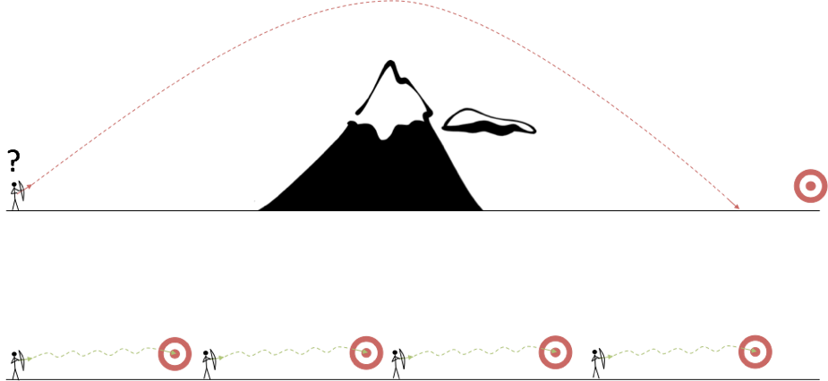
Waterfall
Agile
Notes:
There’s a government tradition of big projects, planned for years, contracted out under massive agreements that specify as much as possible in advance. And when those go awry, the tendency is to assume that what’s needed is more detailed planning. I’ve seen government specifications for yet-to-exist software that went as far as saying what the text on each button should be and where it should be on the screen.
18F don’t play that game. We’re believers in agile development. In archery terms, we take a short shot, correct and shoot again when we miss, and then walk forward for the next short shot.
There has been a history of big government IT projects that planned for years, spent money for years

Slide 32
AGILE
MVP: Humility
Notes:
We need to resist the temptation to keep everything under our hat until some big Apple-style reveal.
In fact, we need to put products in front of our users that we know perfectly well are just barely adequate.

Slide 33
AGILITY
Share
Learn
Prioritize
Iterate
Notes:
And then that barely-adequate MVP is the basis of the next step.
This can be hard for managers in our partner agencies to swallow. They often feel like planning is their *job*, and that not making detailed plans amounts to abandoning their posts.
But the truth is, we need tons of their help to make this work. We rely on massive communication with people throughout their organization. We need their help finding members of the public to put the product in front of. This intensely human process of agile development

Slide 34
Software is never done.
Notes:
That doesn’t mean that we want to be on a project forever. In fact, we look for short engagements.
It does mean that we don’t ever need to reduce the backlog to zero, and we always need to write software that’s ready for the next step.
Tests
Documentation
Refactor for changeability

Slide 35
Not really innovation specialists.
PRACTICES: AGILITY
Notes:
So we’re not inventing brand-new brilliant techniques. We’re applying techniques that are very well-refined in the most advanced parts of the private sector.
But that describes most of us in this room, right? Few of us are inventing utterly new ways to get work done. What we are doing is finding better ways that others have developed and bringing them to bear in new places.

Slide 36
Open by default.
PRACTICES: OPEN
https://18f.gsa.gov/open-source-policy/
Notes:
Now this is a bit of an innovation, and it was one of the most important things drawing me to 18F.
We make this clear up-front to all our partner agencies as a firm condition of engaging us.

Slide 37
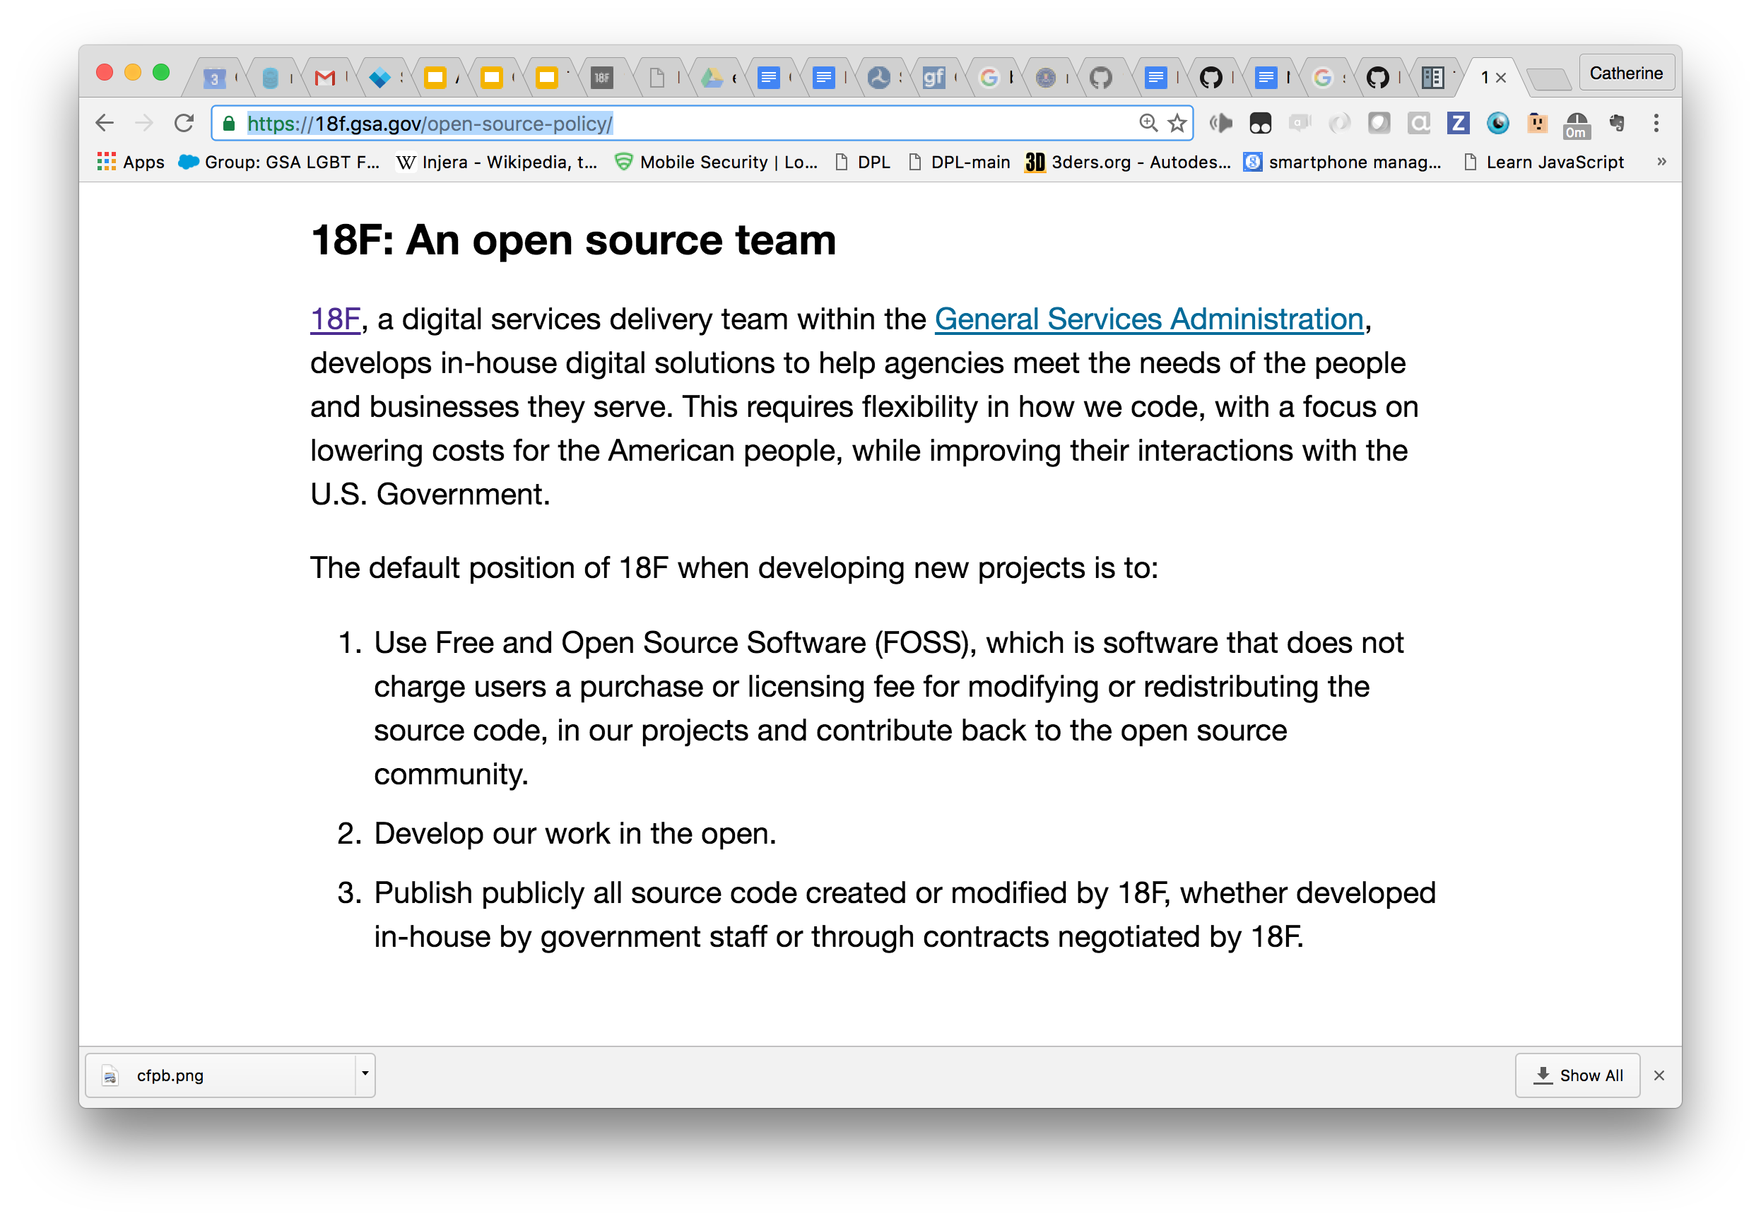
Notes:
I don’t need to this crowd why this is awesome, right?
However, 18F does put a ton of work into communicating the importance clearly to our government partners and across government in general.

Slide 38
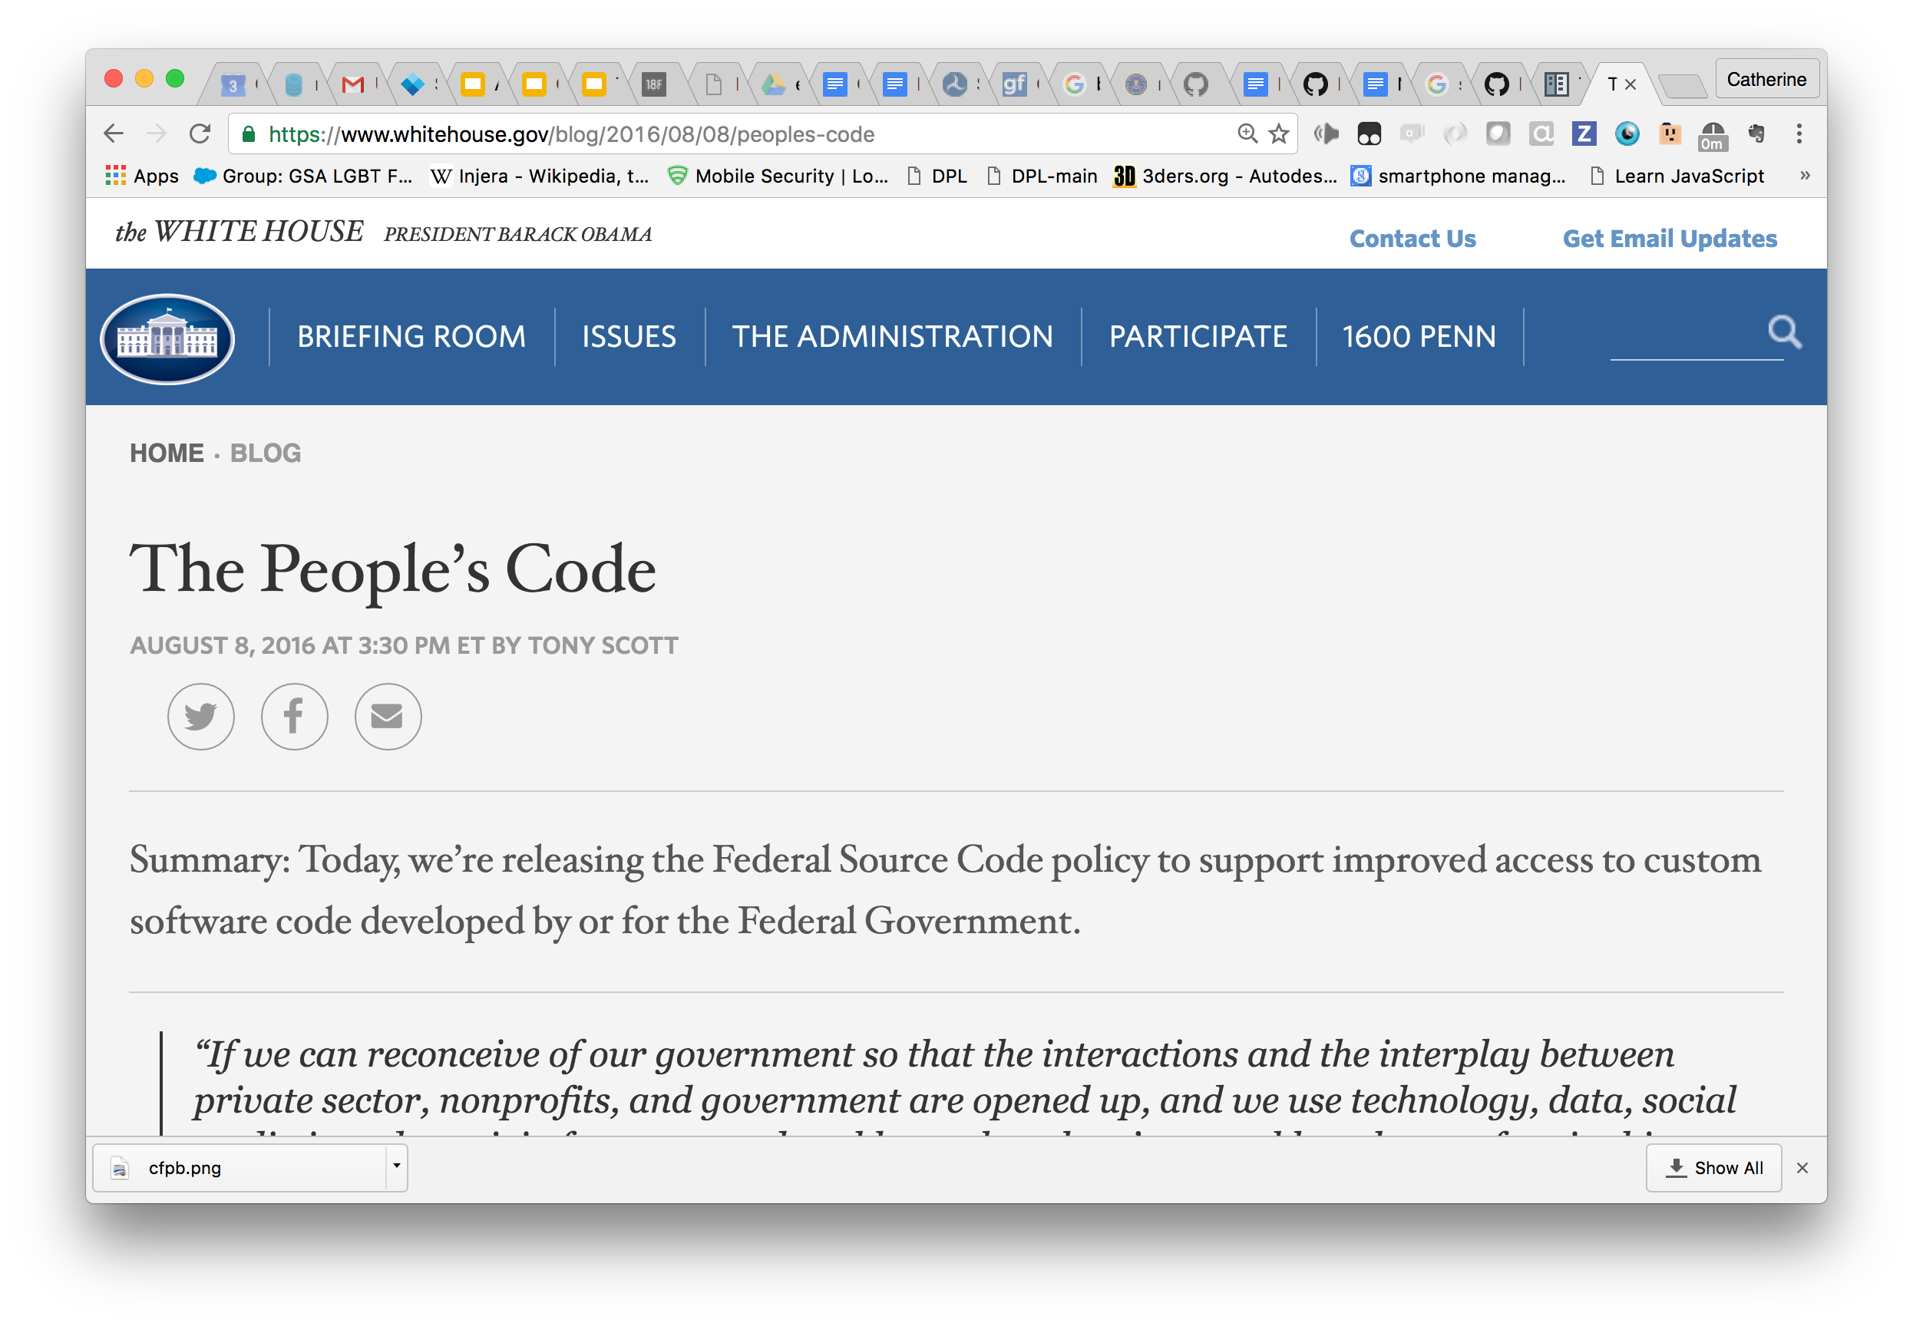
Notes:
This doesn’t make us the kind of crazy rebels you might be thinking. The truth is, there’s strong top-level support for good open-source policies in government. There have been policies encouraging use of open source for years, and this August saw the release of the most pro-FOSS policy yet. But top-level policies alone can’t make change happen.

Slide 39
PRACTICES: HUMAN-CENTERED
Center on humans.
Notes:
We think we’re here at OLF to talk about technology… but really we aren’t.
I once thought of programming as a solitary activity.
We’re here for a social movement, not a technical one.

Slide 40
PRACTICES: HUMAN-CENTERED
Constant communication with
shareholders
Public are shareholders too!
Notes:
Being human-centered sounds obvious, but there are so many other things to think about when a project is starting up. People are thinking about budgets, schedules, deadlines, conflicting priorities within the organization. It’s easy to get wound up in all of that and assume that the result is going to be good for humans.
For techies, It’s easy to be excited about the technology we want to use to solve a problem and build our work around that.
All of that would defeat the purpose of agile. In that archery diagram, it would be like shooting with your eyes closed, because human needs ARE the target. So we need to stay in constant, open-eared communication with all the humans involved - humans in the agencies we work with and especially the public.

Slide 41
PRACTICES: HUMAN-CENTERED
User research
Notes:
So 18F makes a priority of user research - interviewing real users before and during our development. We’ve got 18F pros who specialize it, but if you don’t, you can still do it - it’s a skill you can study and develop like any other.
We often have to make the case for user research - we’ve encountered managers who think that user research is a luxury that we can’t take time for.

Slide 42
PRACTICES: HUMAN-CENTERED
Real users: not optional
Notes:
This Spring I was on a team building a prototype for the Office of Government Payroll, an office charged with collecting paperwork to ensure that contractors on government construction products obey laws guaranteeing their workers a fair wage. We began with intensive and in-depth discussions with our counterparts and OGP, and went away feeling well-informed, ready (I thought) to build our system. In fact, I started writing code right away.
Fortunately, our team included Angela Colter, an 18F user experience researcher, who pushed hard to find end-users who we could interview about their needs. She found an appropriate professional organization and recruited *dozens* of participants to give us the end-user viewpoint on the payroll submission process. And her interviews were full of surprises for us.
We thought that work categories would be evaluated based on the work actually being performed, but they're actually allocated according to what's in the contracts.
We thought hat subcontractors would pay their employees hour by hour according the the type of work they were performing. It turns out they prefer to round up to the best-paid category they work in.
We thought that subcontractors were reliably aware of the wage requirements of the jobs they were working on. We thought that prime contractors were reliably aware of all the subcontractors working in the tree of subcontracting beneath them. It turns out that neither is true!
All that helped us build a prototype that was better-aligned with the users’ reality than if we’d relied on our secondhand understanding of their needs.

Slide 43
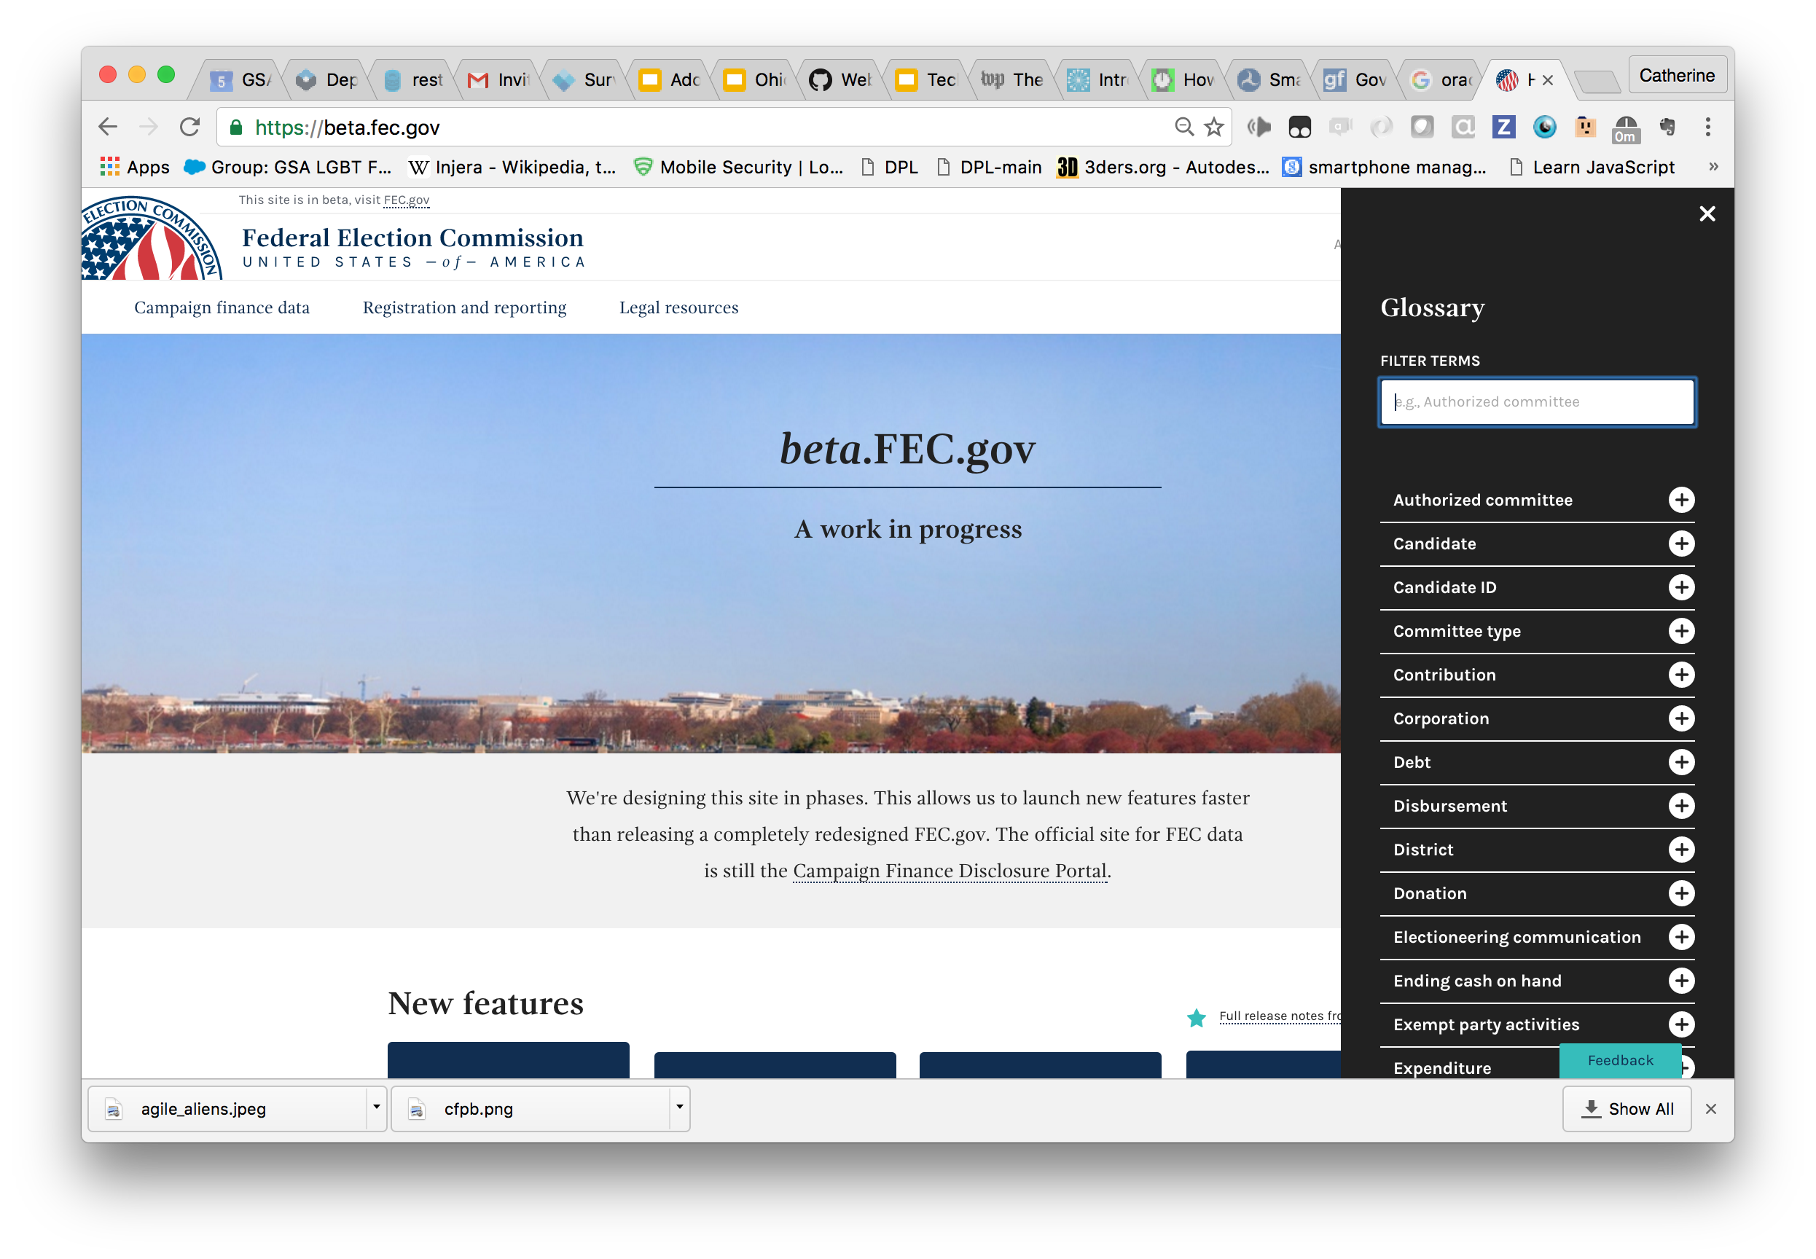
Notes:
Being human-centered also means being conscious of our jargon. The FEC project developed a handy in-browser glossary tool to help translate the legalese of campaign finance regulation into English.

Slide 44
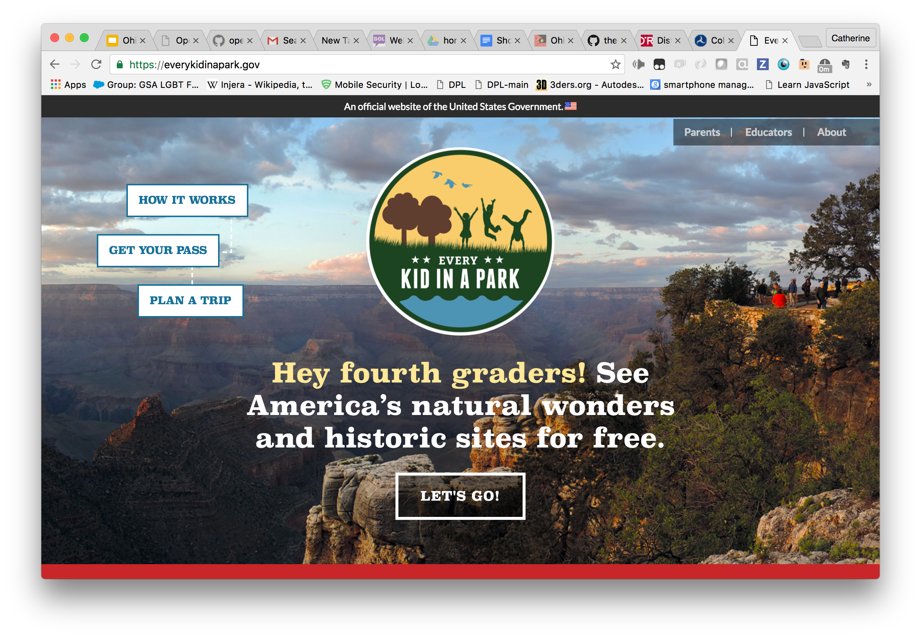
Notes:
One project 18F is fiercely proud of, though I didn’t work on personally, is Every Kid in a Park webpage. This was arguably the ultimate language challenge, because the humans this site is made for are fourth-graders. Can you imagine working with government officials to describe a program’s requirements… in fourth-grade language?
Well, we did it. Never give up.

Slide 45
PRACTICES: HUMILITY
Non-heroism (II)
Notes:
I mentioned when talking about 18F’s people that we’re not a bunch of superheroes. That’s true in another way, too: we’re not heroes in relation to our agency partners. We’re not swooping in, capes billowing, to save helpless agency partners.
OK, let’s keep the capes. The capes are cool.

Slide 46
PRACTICES: HUMILITY
Respect your partners.
Notes:
But, if we’re heroes, then we’re heroes in a cool superhero team-up movie.
In our case, our partners are government employees with many years, sometimes decades, of experience in their fields - . When we work with them, we need to really value that expertise, for their sake and for ours.
We’re bringing valuable knowledge to the table, knowledge that some people look on as if it were sorcery. I mean, we call ourselves “the tech industry”, as if software is the only technology in the world. That’s great, but we need to remember that being experts in one field doesn’t make us experts everywhere.
Capes for everyone!

Slide 47
PRACTICES: HUMILITY
Ask questions!
Notes:
Do you ever nod when people say things you don’t understand?
Stop it. You’re wasting precious resources: the questions on your tongue. Questions are magic. Questions teach you things!
Questions also communicate respect.

Slide 48
PRACTICES: HUMILITY
Find people who have solved similar problems.
Notes:
It’s good advice when hacking software, and when hacking bureaucracy. Unfortunately I don’t think StackOverflow has a clone for bureaucracy, so it takes more effort, but it’s worth it.

Slide 49
Notes:
And then, those fans of openness out there - find them, too. Nothing makes them happier than finding a phalanx of allies, and they can help with the insider knowledge you don’t have.

Slide 50
PRACTICES: HUMILITY
Rules

Slide 51
PRACTICES: HUMILITY
Align yourselves with the rules of the organization.
Notes:
Least popular slide of the presentation, right?
This is hard, but this is how cooperation works.

Slide 52
PRACTICES: HUMILITY
Rules != Procedures
Debunk legendary rules.
Notes:
The government has multiple levels: laws, policies, procedures.
For example, the Paperwork Reduction Act is a 1995 law that is supposed to reduce the bulk of forms that government makes citizens fill out. The PRA is often misunderstood in government, however, as banning activities like user research conducted by government. You’ll often be told a flat “no, that’s not allowed”. Sometimes you need to push, get the actual policies or regulations or laws in your hand, and find out better.

Slide 53
Notes:
Remember that rules don’t have to be negative! Rules can provide the positive pressure, too. Know your rules!

Slide 54
Humility via API
Notes:
18F practices API-centered development. I argue that that’s a form of humility.

Slide 55
NO API
DB
web
app
Notes:
This is how most of us used to write web apps.
There’s an arrogance here: an assumption that we, the Mighty Web Developers, can and shall be the ultimate gatekeepers to the data, anticipating all needs.

Slide 56
app
API-CENTERED
DB
API
web
app
app
Notes:
18F has professional designers who produce beautiful graphics. I’m not one of them.
API-based design decouples decisions made for the server side from decisions made to present the data.
A good API forms a gateway to the data that can be used by the app we build, and by other apps the agency will build in the future, and by members of the public with their own ideas for how to use and present the data. Power users may even use the API to download data directly.
This is a humbler way to design.

Slide 57
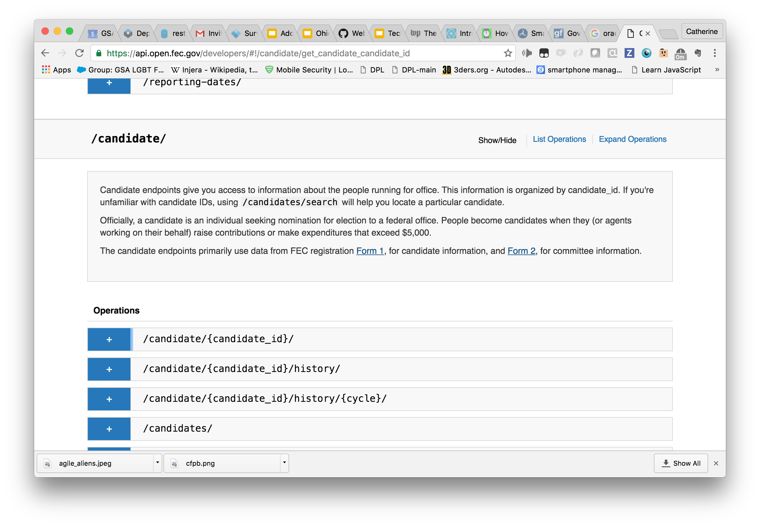
https://api.open.fec.gov/developers/
Notes:
One great example of an API is the one that underlies beta.fec.gov, and you are extremely welcome to try it out. The web interface to the API can help you devise queries...

Slide 58
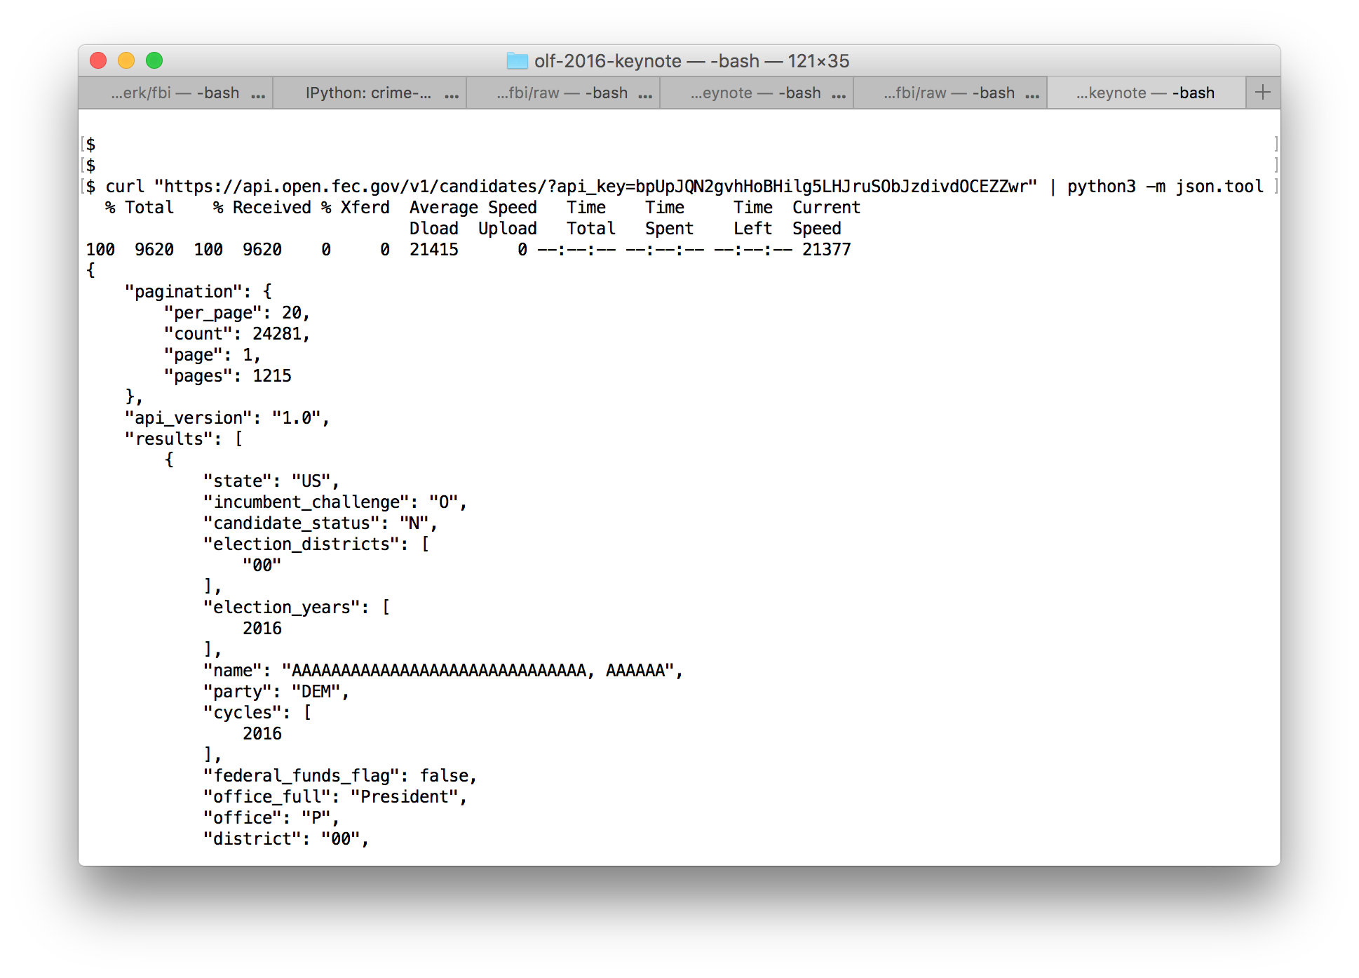
Notes:
… but the queries don’t need a web client to run; they can be run with a tool as simple as curl.
This JSON is easy for a web application front-end to consume; or for a script to process; or to pipe into a data analysis program. JSON has become a sort of lingua franca for data exchange.

Slide 59
PRACTICES
Make the right thing easy.
Notes:
When you go to encourage people to do things different, there’s a terrible filter in their brain, telling them, “Here’s somebody who wants me to spend extra effort, effort that I know will detract from my real job.”
Can you pave the way for doing things right?

Slide 60
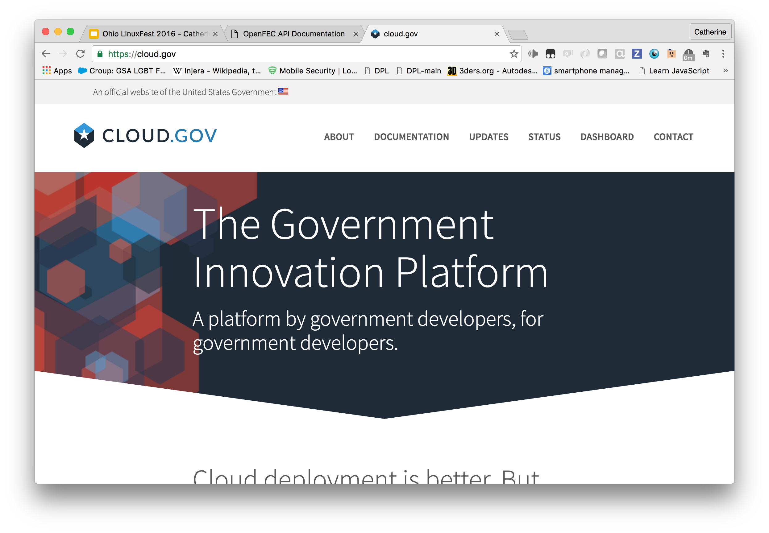
Notes:
One of the greatest pains of any project in the Federal Government is the dreaded Authority to Operate.
The ATO is intended to ensure that any application deployed meets all appropriate security criteria. Unfortunately, when it’s done traditionally - by hand from scratch - it can resemble an attempt to murder the development team by burying them in paperwork. Completing a new application’s ATO can take and cost as long as the application development itself. Dread of completing a new ATO, or even of updating an existing one, can be a huge disincentive to updating government applications.
Cloud.gov, a hosted service provided by 18F for government customers, gives everyone a platform to host government applications on for which the infrastructure layers of the ATO are essentially already complete. Best security practices are baked in. Serving the app responsibly becomes the *easy* thing.
My colleague, Steven Harms, is 1:00

Slide 61
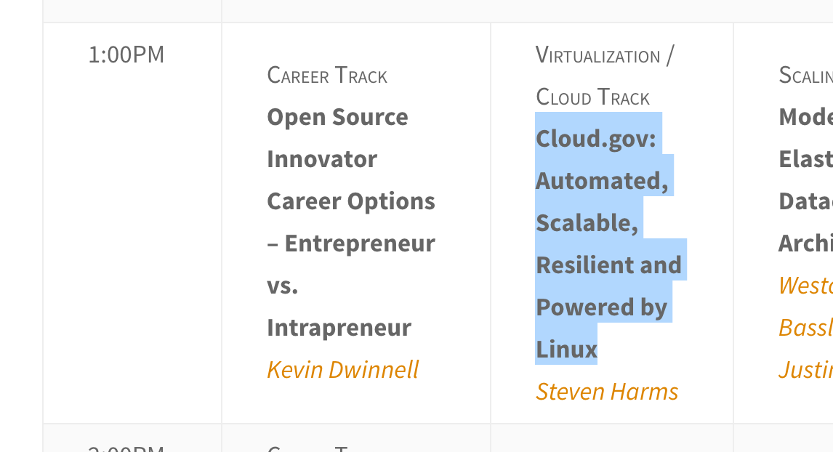
1:00, Union B

Slide 62
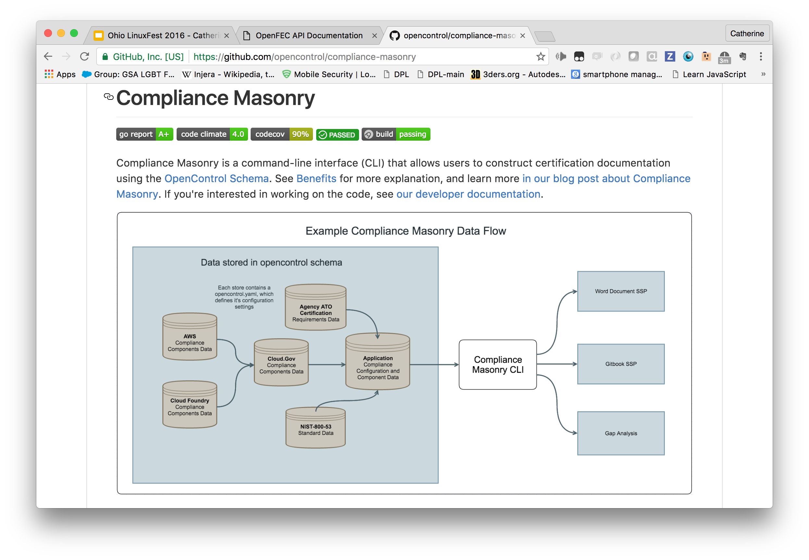
Notes:
Compliance-toolkit and compliance-masonry:
ATO paperwork hinges on lenghty documents asserting that the systems in question are in compliance with all appropriate security “controls”.
Of course, since the document is full of *assertions*, it would be reasonable to doubt their truthfulness… especially as time passes. Is the documentation really still in synch with the system’s reality?
Worse, the need to update the documentation can become a disincentive to updating the system.
The compliance-toolkit helps you generate prose documentation, suitable for ATO certification - or your own organization’s needs - that is generated at will with the aid of queries run live against the actual system. It keeps documentation and reality in synch.

Slide 63

Notes:
18F has great visual designers, but we didn’t want to just produce good design for the sites we work on directly - we wanted good and responsible design to be available across the government. So 18F and USDS designers together produced the U.S. Web Design Standards — a set of user interface components and a visual style guide designed specifically for federal government websites. The standards look great and ease the burden of producing a site.
Each of the features is 508 accessible, mobile responsive, and open-source.

Slide 64
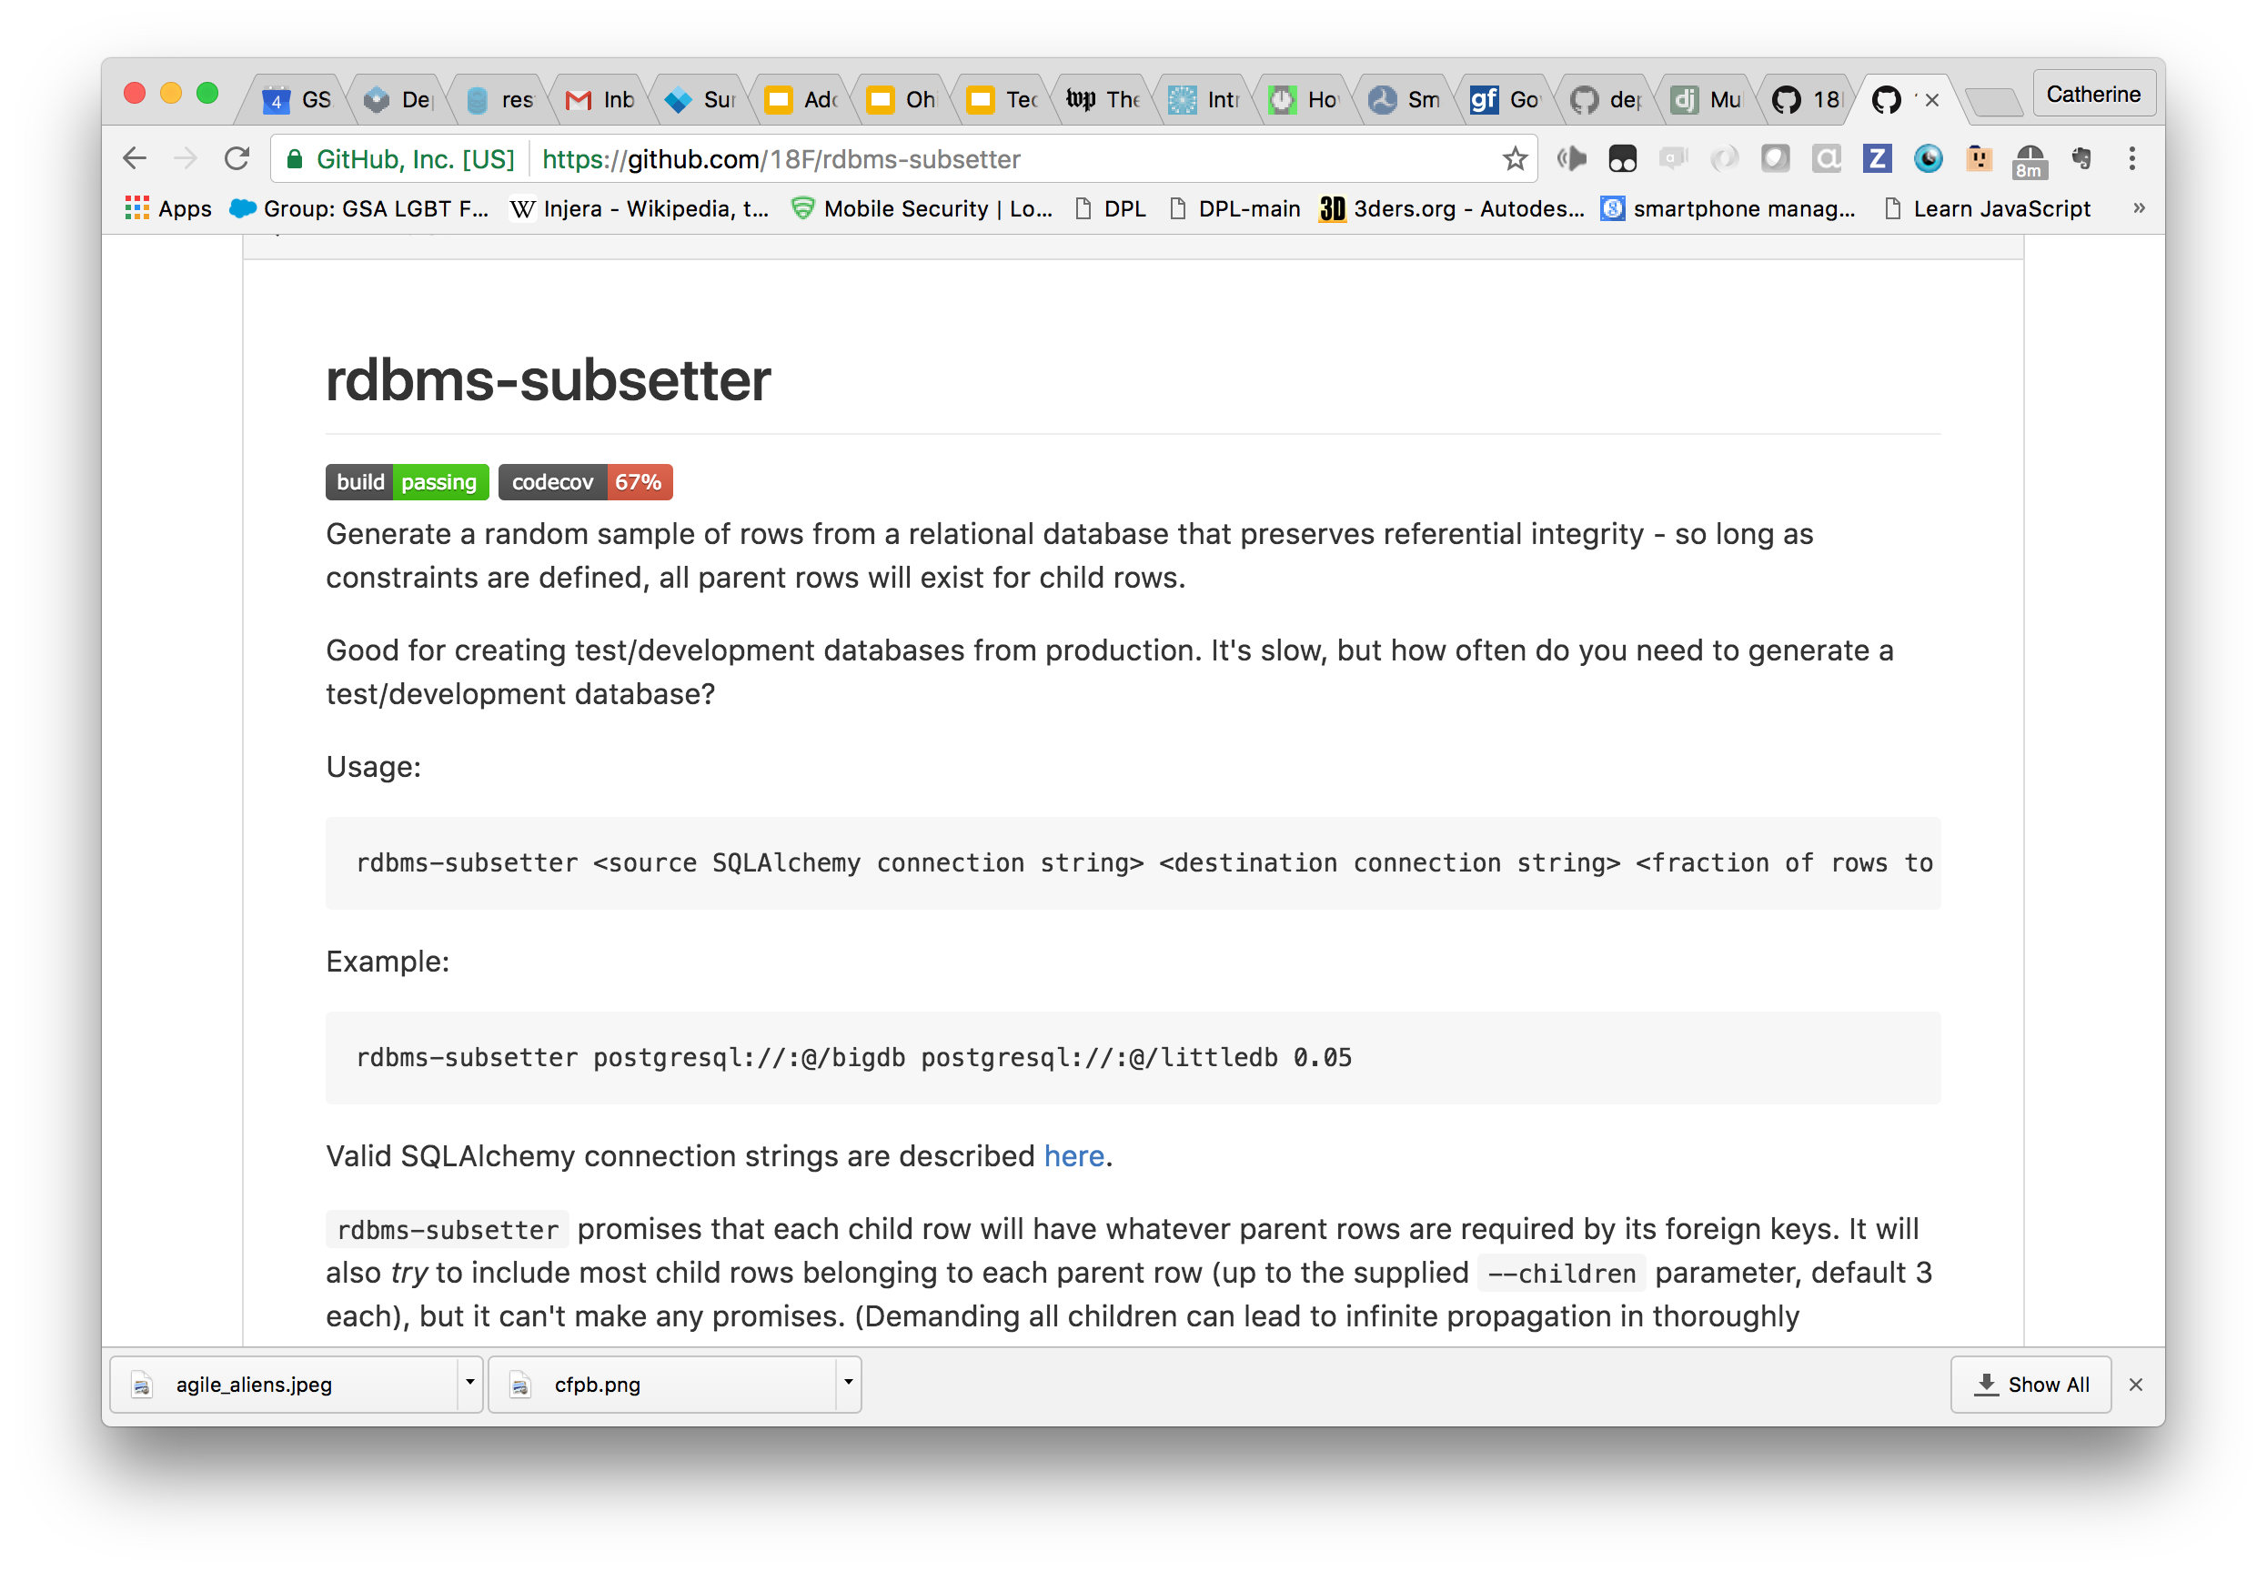
Notes:
I do ugly database-level stuff, so my story is less cool. But test-driven development is one of those practices we love, even when we’re writing an app for a legacy database. Here’s a tool I wrote at 18F to extract a small testing database from a large, unwieldy legacy database, making testing - the right thing - easier.
I was fairly new at 18F when I wrote it, and the best thing was when I asked the procedure for pushing an 18F project to the Python Package Index. The procedure is, “Do it.”

Slide 65

Notes:
You may have noticed, all of those make-it-easy efforts come from dog-fooding - from building and using the tools we need to work within government ourselves. It’s a great motivator! One way to have good communication from a user of your tools is to use your tools.

Slide 66
3/ Culture
PART THREE
Notes:
I could go on and on, but the upshot is that we use development practices much like the ones you would. But just using the right practices isn’t enough.

Slide 67
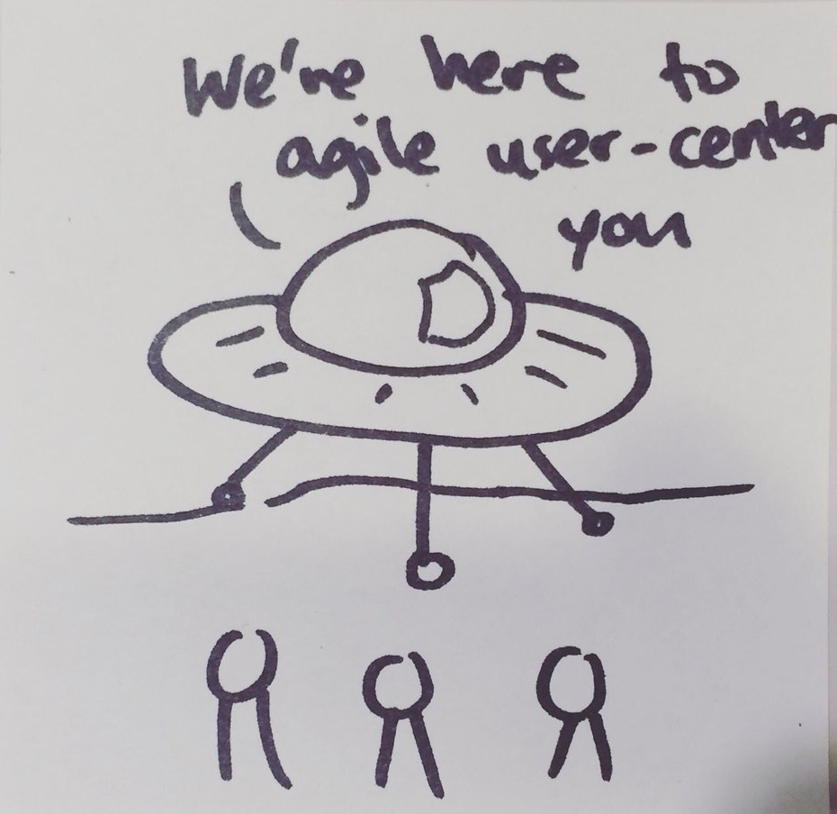
Notes:
If we land in government like some aliens, babble jargon nobody understands, drop off some web apps, and zoom away into the night sky, we fail. We need to make changes that go way beyond the projects we actually touch. We need to help seed something bigger, to change the entire culture in public service.
Thanks to Jesse Taggert and Nikki Lee for this cartoon!

Slide 68
Be the change.
lead by example
instruction
hands-on assistance
Notes:
First — we intend to lead by example, by instruction, and with hands-on assistance.

Slide 69
CULTURE: BE THE CHANGE
Be the visible first mover.
Notes:
It can be very confusing in government, knowing what you’re supposed to do and what you’re allowed to do, and the path of least resistance is always to look at what somebody else has done, and follow suit.
Just providing precedent is one of the most valuable services you can provide i

Slide 70
CULTURE: BE THE CHANGE
Be the visible first mover:
Choose for impact!
Notes:
If an agency asks 18F to work on a project, it’s far from an automatic “yes”. Our intake group carefully selects projects that we think will advance 18F’s overall mission of transformation.
One of its most important criteria is impact. We want to choose work that’s visible, that people inside and outside government will care about, for the maximum ripple effect.
It’s easy to fall into polishing a pet project to beautiful perfection, and forgetting to ask how much impact it really has.
My most recent project for 18F was to help improve the placement and care of refugee children who arrive alone in the U. S. Impact!
My current project is to help improve the FBI’s reporting of national crime statistics. It’s a

Slide 71
CULTURE: BE THE CHANGE
Involve your partners.
Notes:
When describing agile, I talked about the importance of communication to the success of an individual project.
It’s even more important for another reason - we want people to get to know these ways of working, fall in love with them, and be able to use them and promote them after the engagement is over.
Give a man a shark, teach him to catch sharks, yada yada yada.

Slide 72
CULTURE: BE THE CHANGE
Memorialize
Notes:
And then - document! Documents help others follow in your footsteps, and they give people throughout the org something to point to. You can’t be an effective, visible first mover if people can’t read about what you did and how.
Because our work is all conducted open-source, our GitHub repositories are one way of memorializing our work. But, frankly, expecting people to go read the repos is a bit of a let-them-eat-manpages attitude. Remember: human-centered. We’re not talking documentation that exists for its own sake. Document to communicate, not to check a box or to CYA.

Slide 73
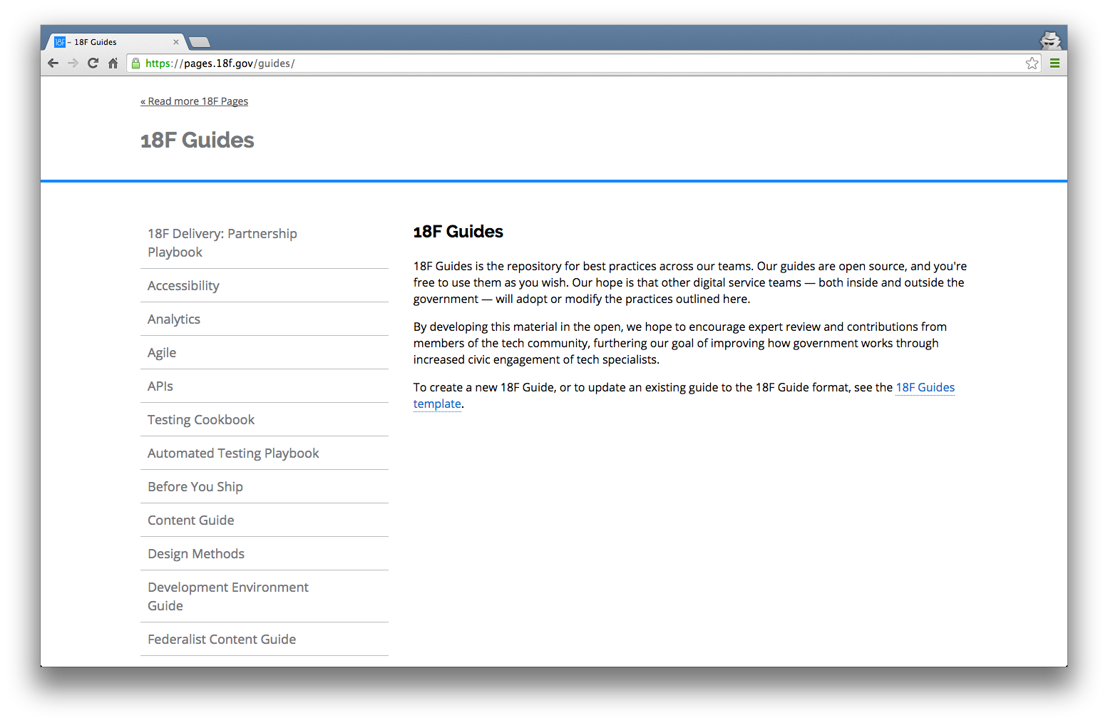
Notes:
What does that look like?
18F Guides (hosted on 18F Pages) is the repository for these best practices. Our guides are open source, and you're free to use them as you wish. Our hope is that other teams — both inside and outside the government — will adopt or modify these practices.

Slide 74
Accessibility
Analytics
Agile
APIs
Automated Testing
Before You Ship
Content Guide
Design Methods
Frontend
Lean Product Design
Open Source Guide
guides.18F.gov
(a few of them, anyway)
Notes:
We’re taking the processes, practices, and artifacts that make us a high-functioning, agile, human-centered team; documenting the heck out of them; and turning them out for the benefit of our partners, other government agencies, and the wider public.

Slide 75
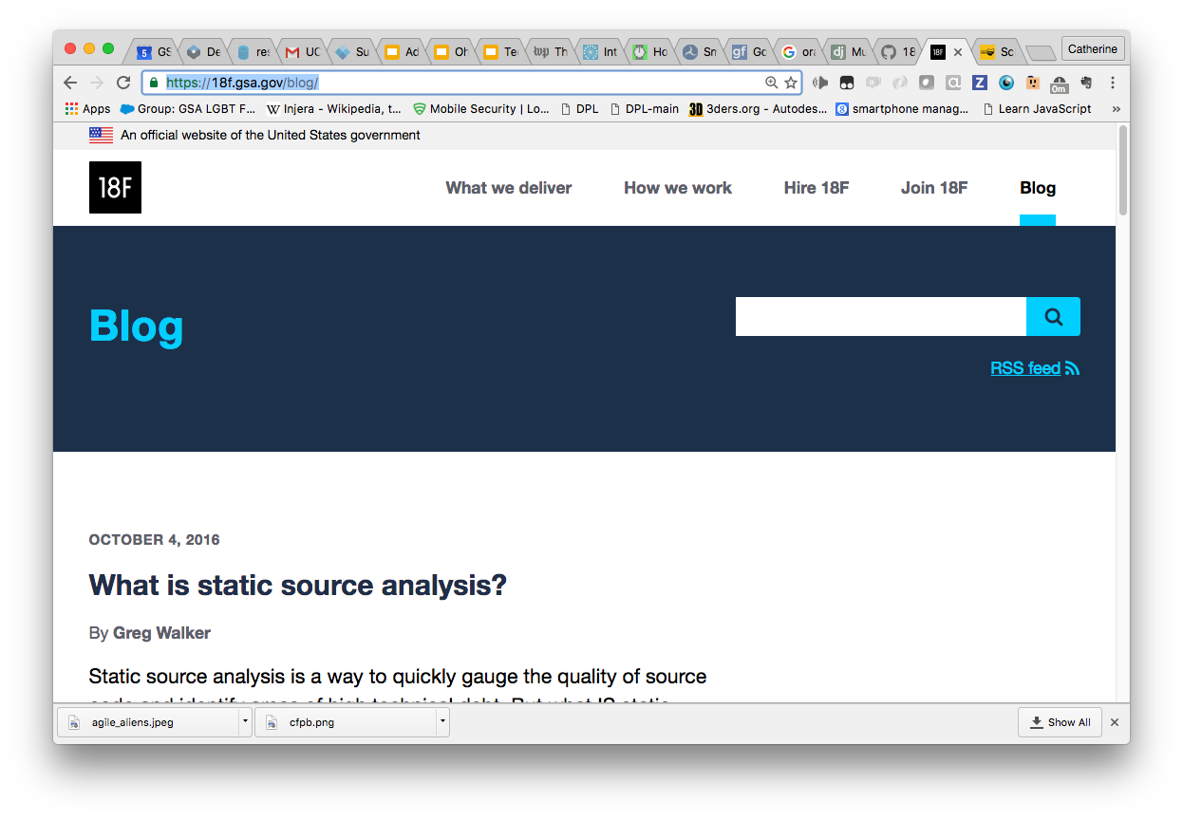
Notes:
Guidebook entries can be kind of passive, though, so we also keep a blog. It’s a great way to get an ongoing window into what we’re up to.
I’ll be really sad if everybody here doesn’t subscribe by the end of today.

Slide 76

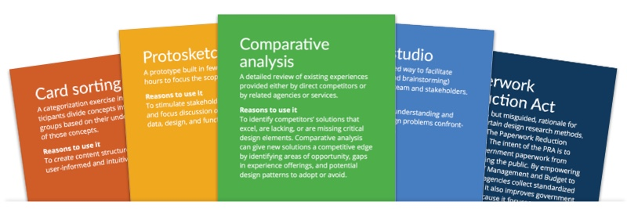
18F Design Methods
methods.18f.gov
Notes:
What began by our design team wanting to define and communicate their practices more clearly internally. That focus on widespread communication soon produced the 18F Design Method cards, available for anyone to download. They’re a tangiable physical prop to help communicate and use techniques of modern research and design. Download your deck today… I have a deck with me if anybody wants a look.

Slide 77
SHIPPING CULTURE
Diffusion
Success stories
Fans
Disciples
Notes:
We don’t have top-down power at 18F. We aren’t empowered to break into government offices shouting, “Drop the Gantt charts! Open up your codebase!”
But diffusion leverages public servants’ actual desire to do a good job. Even if it looks buried under years of cynicism and despair, it’s there, waiting to flare into life.

Slide 78
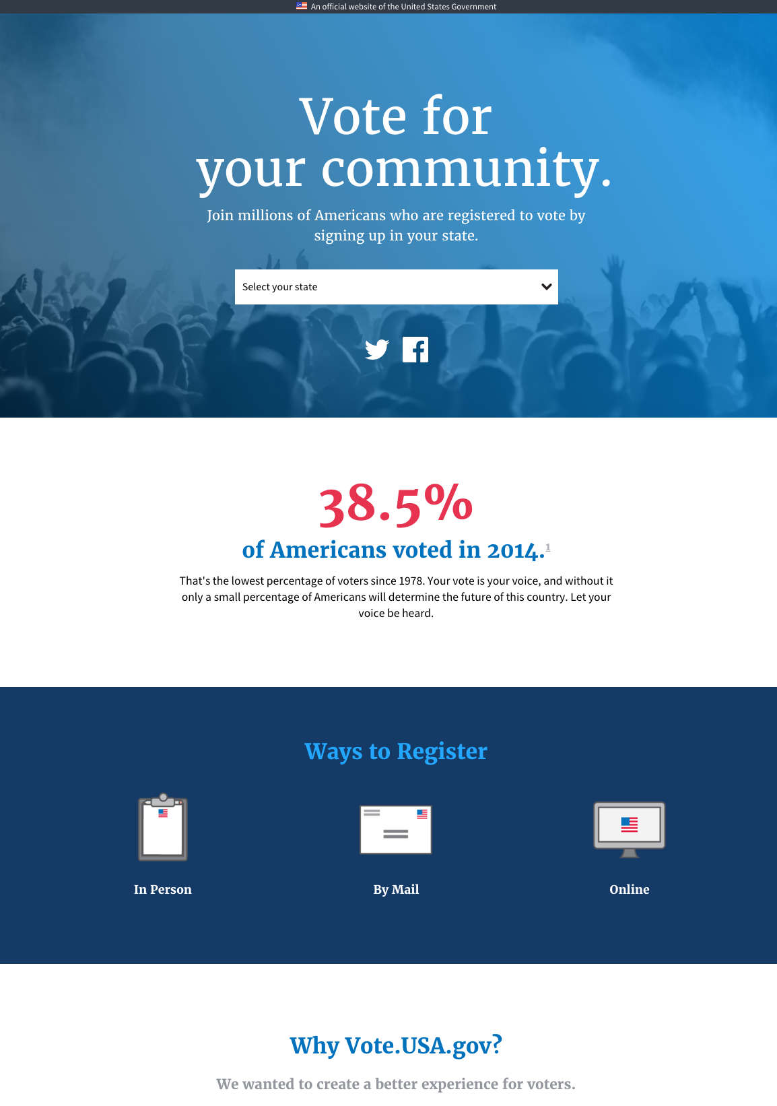
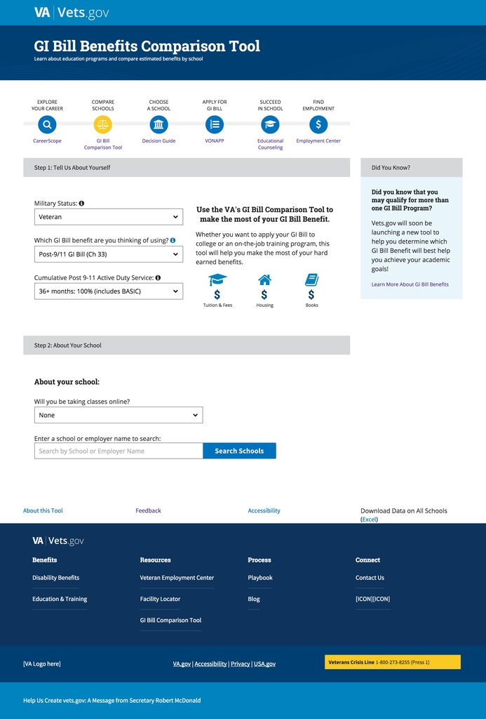
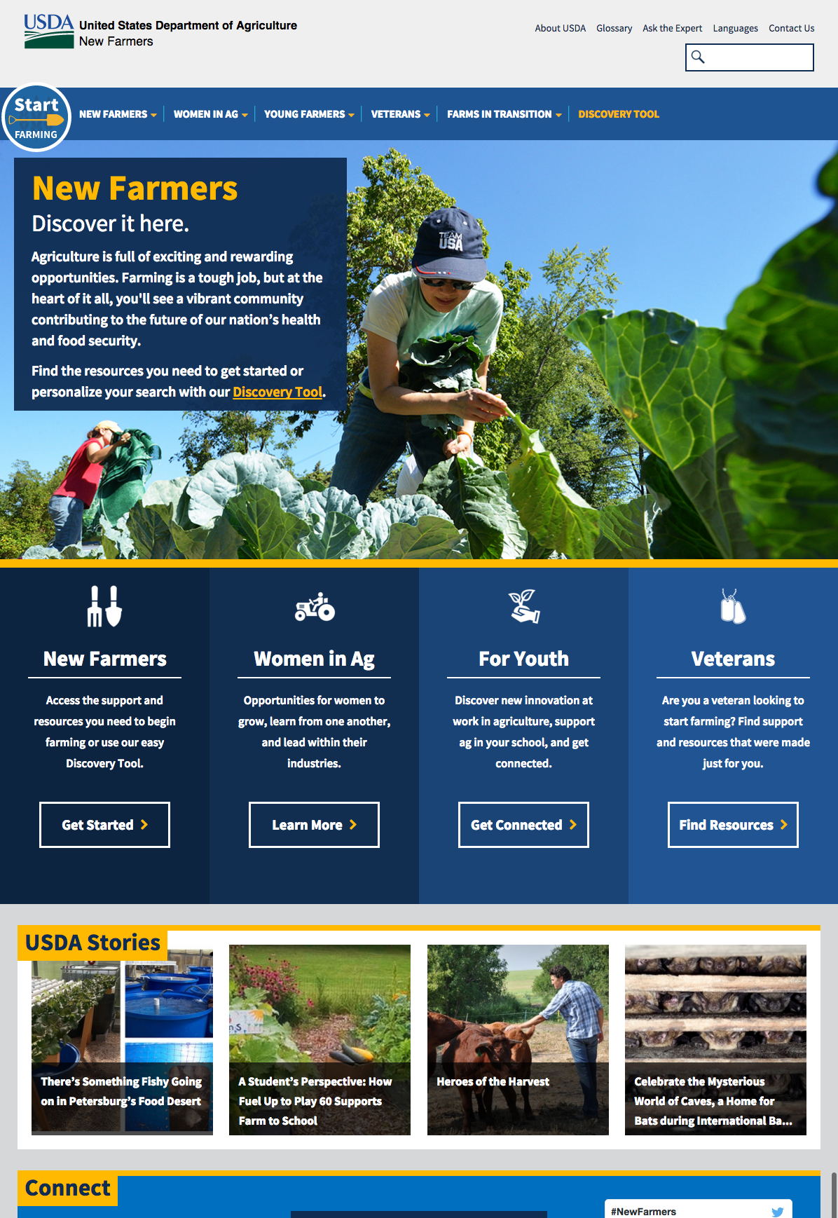
Notes:
Federal websites are embracing the US Design Standards. Vote.usa.gov is a recent favorite,

Slide 79

Notes:
We love telling the story of Larry from OASIS as an example of culture change, which I’ll abbreviate - Larry had approval to build a tool that OASIS was certain its users needed.

Slide 80
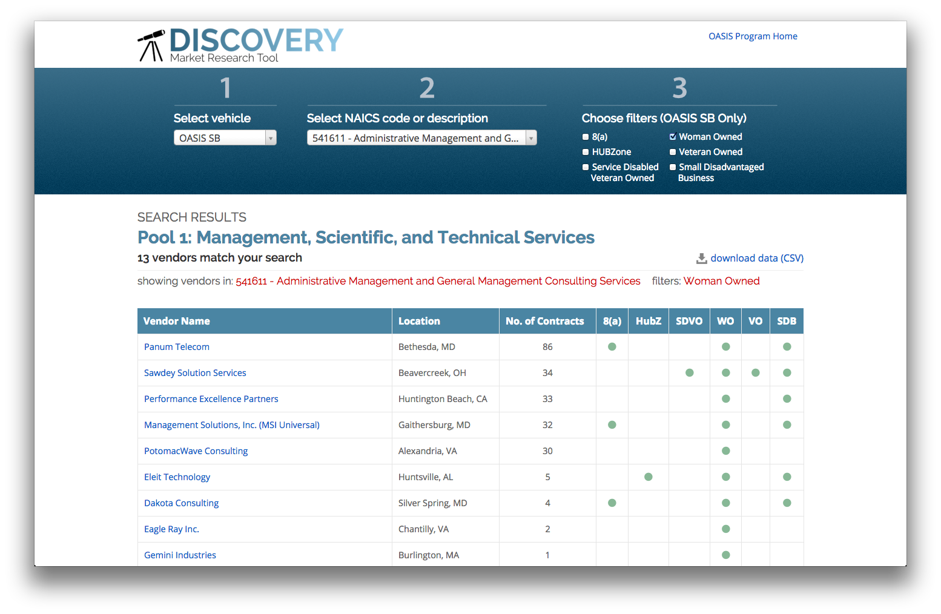
Notes:
So we did the user research, and it turned out that the users needed a different tool altogether.
Here’s where Larry hit a home run. He chose the users’ priorities over his own and his organization’s expectations and plans. He went back up to his supervisors, research in hand, and got permission to build what the users were actually asking for.

Slide 81
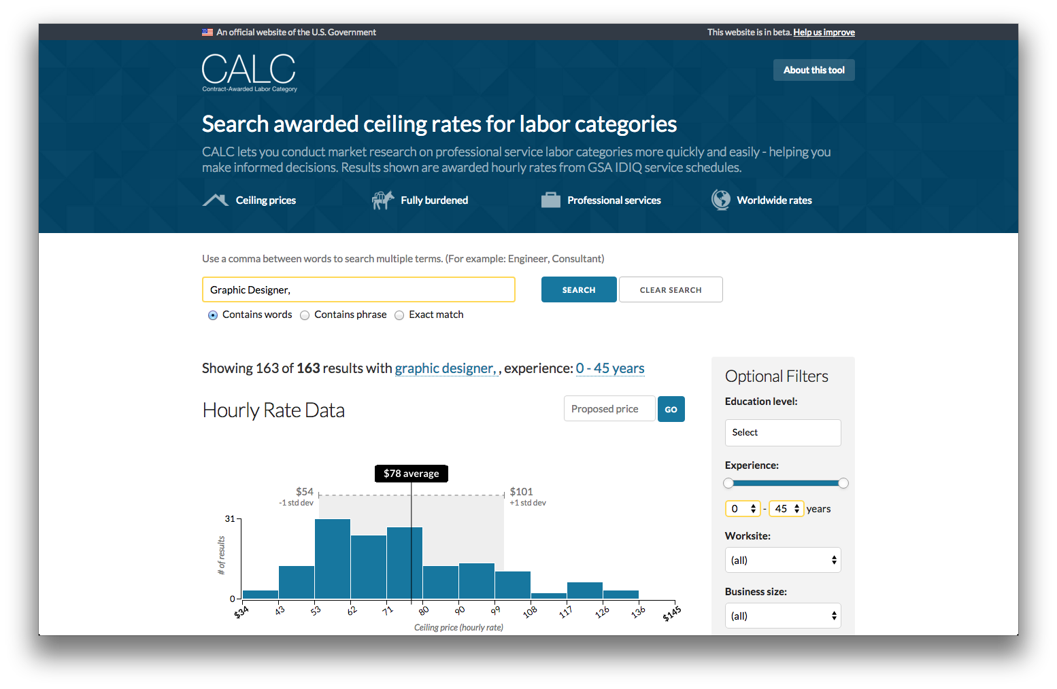
Notes:
And so we did.

Slide 82
“WOW — I saw your blog post announcement for the Contract Awarded Labor Category Tool (CALC) and all I gotta say is WOW! I am not sure why trumpets are not blaring, horns are not tooting and bells are not ringing! This is truly a great day. This tool will make the whole process a whole lot more accurate, easier and faster.”
Notes:
And that tool launched to rave reviews like this one. Just to be clear: this is someone saying the angels should be singing about a procurement tool. That is transformation gold. And now Larry tells anyone who’ll listen about user centered design and agile and the benefits of working in the open.

Slide 83
Boulder
Philadelphia
Sacramento
Santa Monica
Anchorage
Tennessee
Boston
New York City
Beyond Federal
(a few of them, anyway)
Notes:
I want to see Ohio on this list.

Slide 84
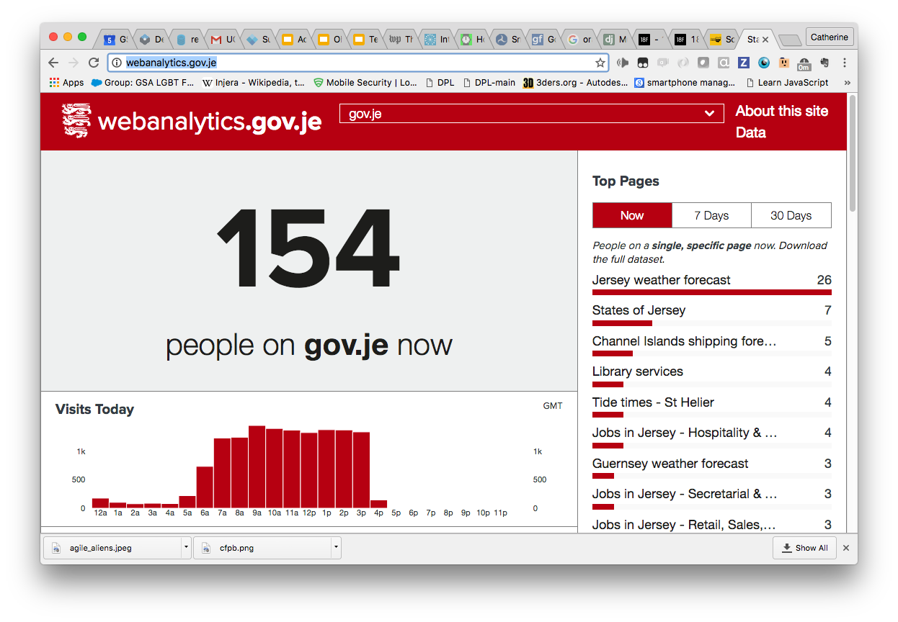
Notes:
The analytics.gov framework you saw earlier has been adopted by a variety of states and cities, and even by Jersey.

Slide 85
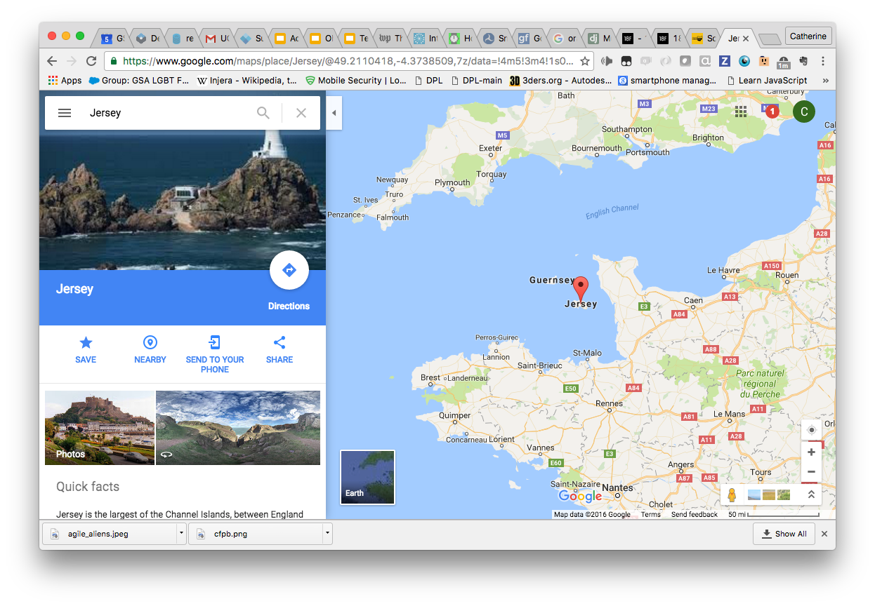
Notes:
No, not New Jersey - Jersey. Right here.

Slide 86



Notes:
Last fall, California’s released a Request for Proposals for a new child welfare case management system. The current system is unwieldy, outdated. It actually loses records -- thousands of the state’s most at-risk kids literally get “lost in this system.”
So officials did what they do: They wrote an RFP. It was fifteen hundred pages long, seeking a single vendor to build the entire new system, with a long list of predefined requirements, at a cost of hundreds of millions of dollars over the course of several years.
A Code for America member saw that RFP and recognized it as a recipe for disaster. Not only does that style of RFP demand a long-shot waterfall process - just the heavyweight style of the RFP narrows the selection of potential contract winners to a tiny handful with large legal departments and, all too often, outdated engineering departments.
So the 18F logo was projected from a large spotlight, and the federal Department of Health and Human Services (essentially a major investor in this system) went out on a limb, became our client, and paid for 18F to help California rewrite that RFP.

Slide 87
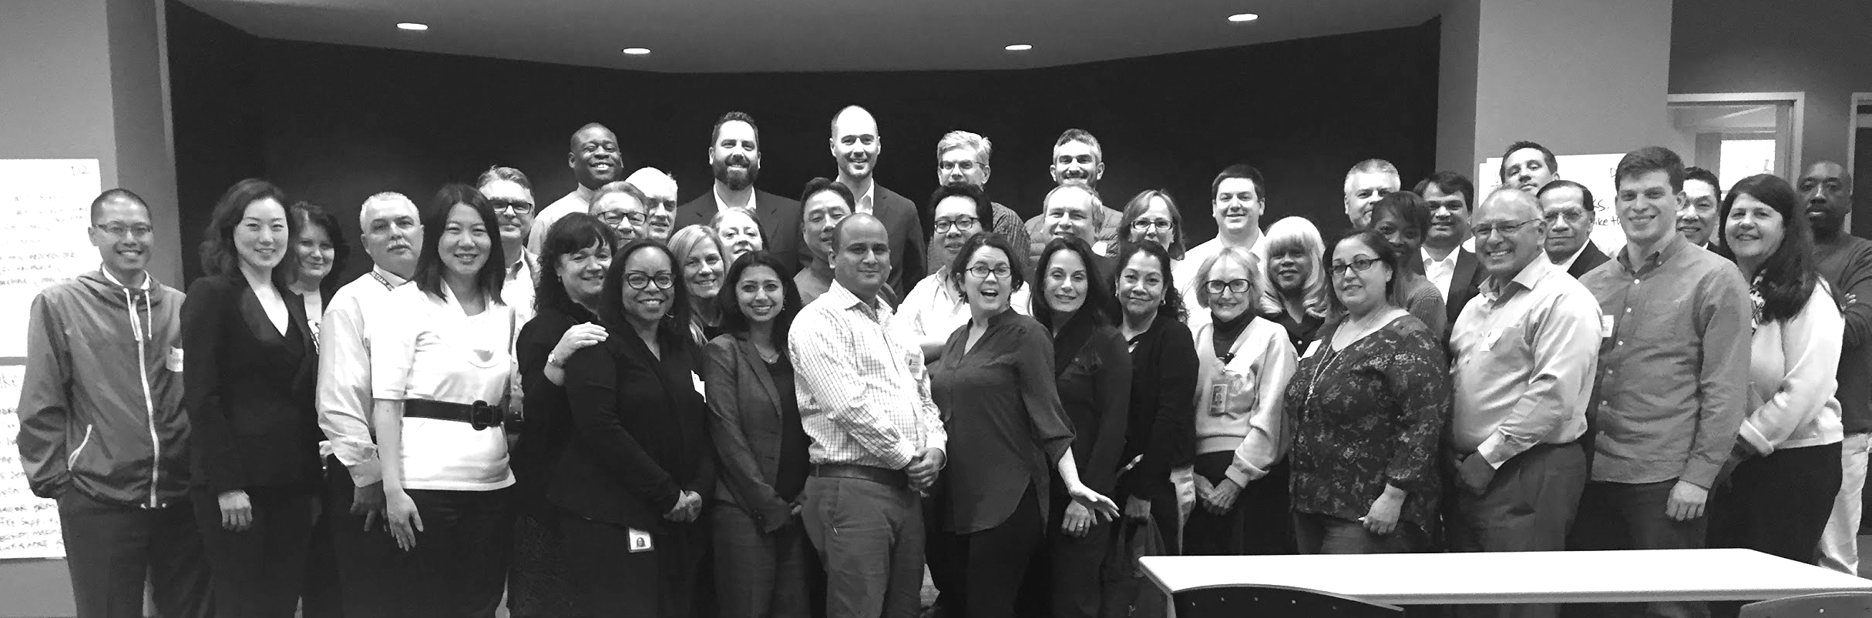
1500-page RFP → two initial 70-page RFPs
Estimated 50% cost savings
Notes:
An 18F team flew to Sacramento and led a workshop for dozens of officials across state offices — some of them initially very skeptical — to get everyone on board with modular contracting and the modern methodologies I’ve been preaching. That 1,500 page RFP was broken out two initial smaller RFPs. The first has a ten page statement of work (plus 60 pages of mandatory legalese). The reason the length matters is because it’s more friendly to non-traditional government vendors, enabling a larger pool of vendors to submit a bid, which should help increase competition and improve the final product.

Slide 88
“We’re experiencing
something of a revolution here.”
Notes:
One of our contacts in Sacramento wrote to tell us that things are, indeed, changing. More agencies in California want to run the same play. Other states want to run the same play, and at least one has already copied the RFPs for their own procurement. That is why we’re here. Little by little, bit by bit…leading to big change.

Slide 89
SHIPPING CULTURE
18f.gsa.gov/tags/agile-bpa/
micropurchase.18f.gov/
18f.gsa.gov/join/
Code for America
Notes:
I hope you’ve gotten some ideas to help transform the places you’re already in. But if you’re dying to get involved with us… if you want to help make “good enough for government work a compliment again…”

Slide 90
It’s hard to ask change managers for help.
Notes:
There are a lot of professional change consultants who promise to help organizations transform themselves, but I think we - not 18F, but everybody in this room - have an advantage over them.
Why? Well, it’s hard for most people to ask “change managers” for help. Folks feel shame, and pride, and anxiety about getting in trouble for potentially having been doing it wrong all along. It feels like saying they don’t know how to do their jobs.

Slide 91
It’s easy to ask computer people for help.
Notes:
But it’s easy to ask the computer nerds to do computer things. Government people aren’t supposed to know that stuff. It’s not in their job description, not part of their identity, not expected.

Slide 92
Transforming lives.
Notes:
We are - all of us here - in charge of making this digital age into a blessing and not a curse. It’s going to take a ton of learning and change within our organizations.
We can. We will.

Slide 93
Thank you!
From 18F
Catherine Devlin
Innovation Specialist
@catherinedevlin catherine.devlin@gsa.gov
@18F

